Slide 1
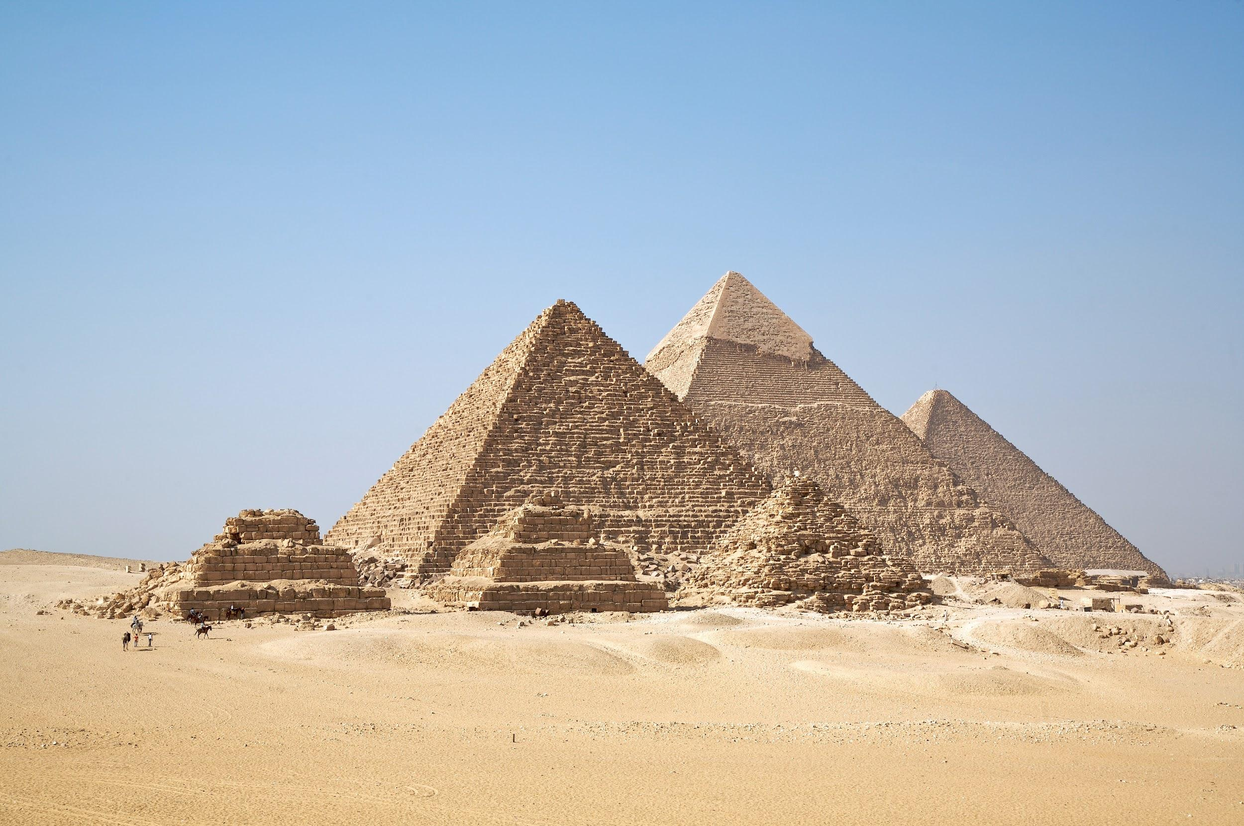
Aspects of a Civilization

Slide 2
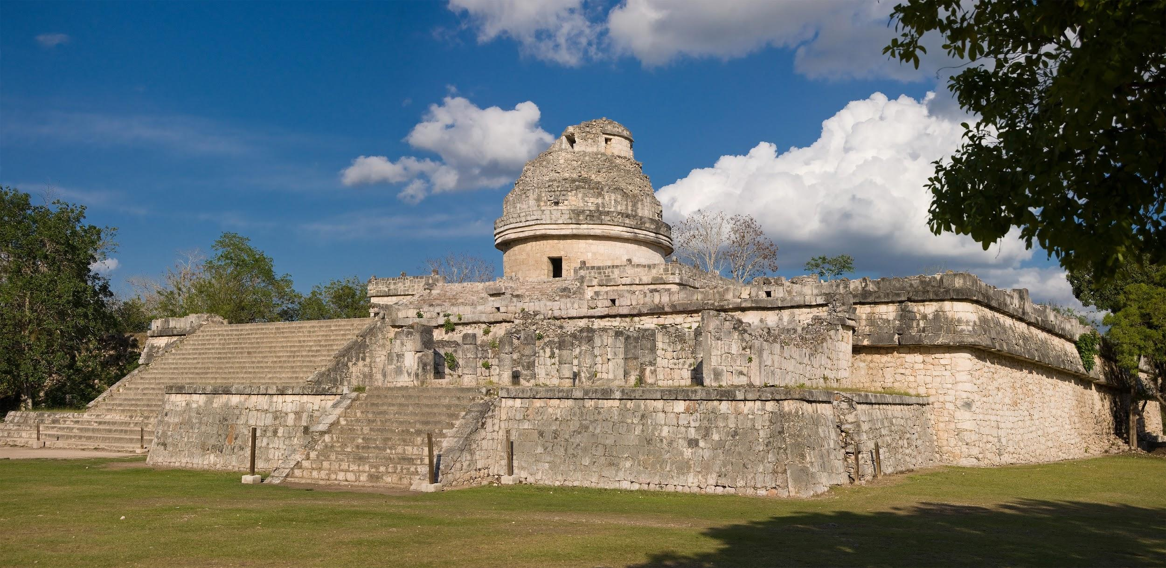
Aspects of a Civilization
Today you will be examining the various aspects (characteristics) that most ancient civilizations shared. As you take notes on these aspects, be sure that you write down each of the following:
The Name of Each Aspect.
A Description of Each Aspect.
An Example of Each Aspect.
A picture of Each Aspect.

Slide 3
Agriculture & Food Surplus:
A way of exploiting the environment by increasing the productivity of those plant and animal species most beneficial for human beings, and storing the extra food for times of famine and drought.
The raising of plants and animals for food, and storing the extra food for times of famine and drought.

Slide 4
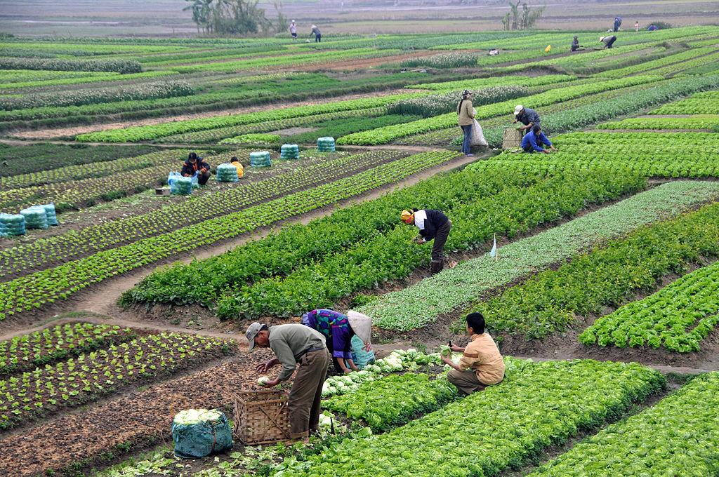

Slide 5
Religion:
A set of beliefs and practices that concern humanity’s relationship with the spiritual, the supernatural, and reality.
Belief in a higher spirit/power and an afterlife.

Slide 6
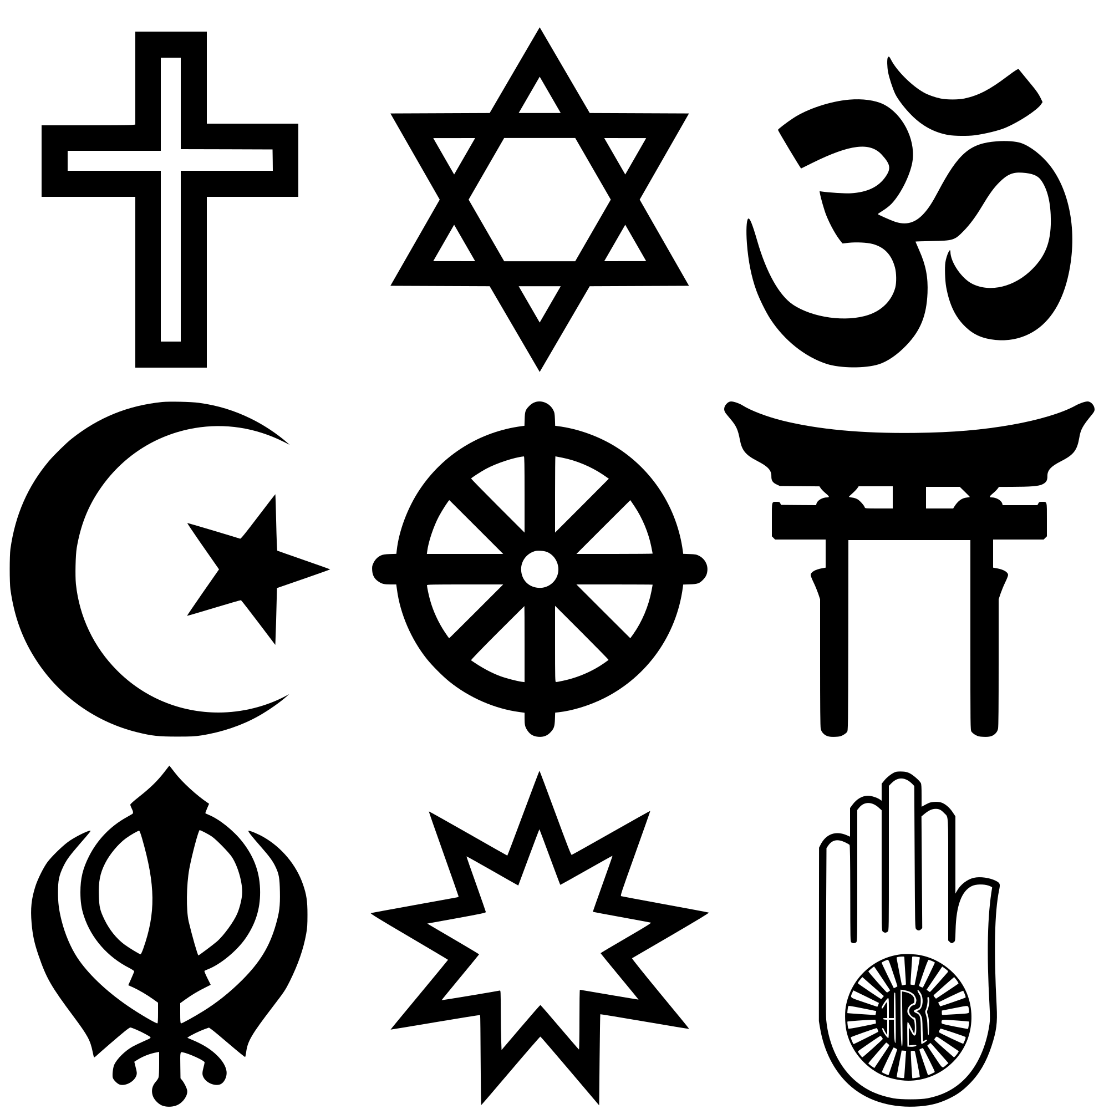

Slide 7
Government:
A person or group of people who maintain leadership and control over a city, state, or civilization.
Those who create and maintain order and stability.

Slide 8
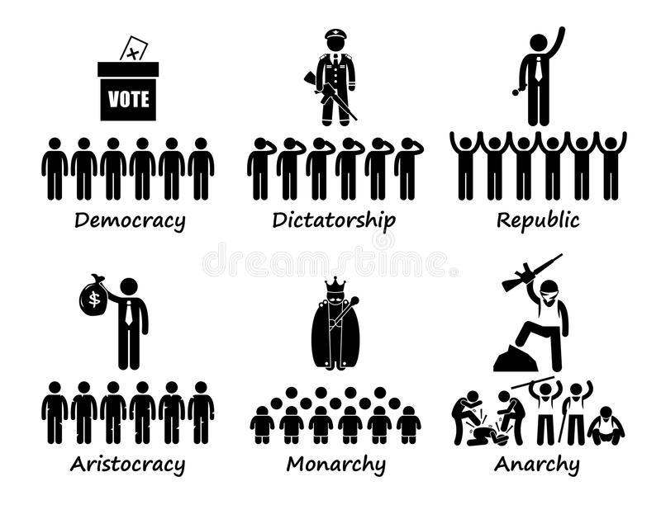

Slide 9
Specialization (Division) of Labor:
The various different jobs that exist within a society.
People doing different jobs (not just farming).

Slide 10
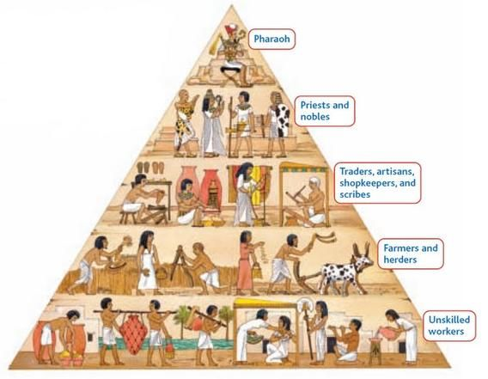

Slide 11
Social Hierarchy:
The division of society often based on factors such as wealth, religion, or power.
Social classes: who is at the top, in the middle, and at the bottom.

Slide 12
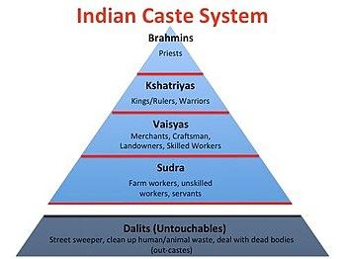

Slide 13
Economy & Trade:
The production, distribution, and consumption of goods and services within or between civilizations.
How people get the goods and services they need.

Slide 14
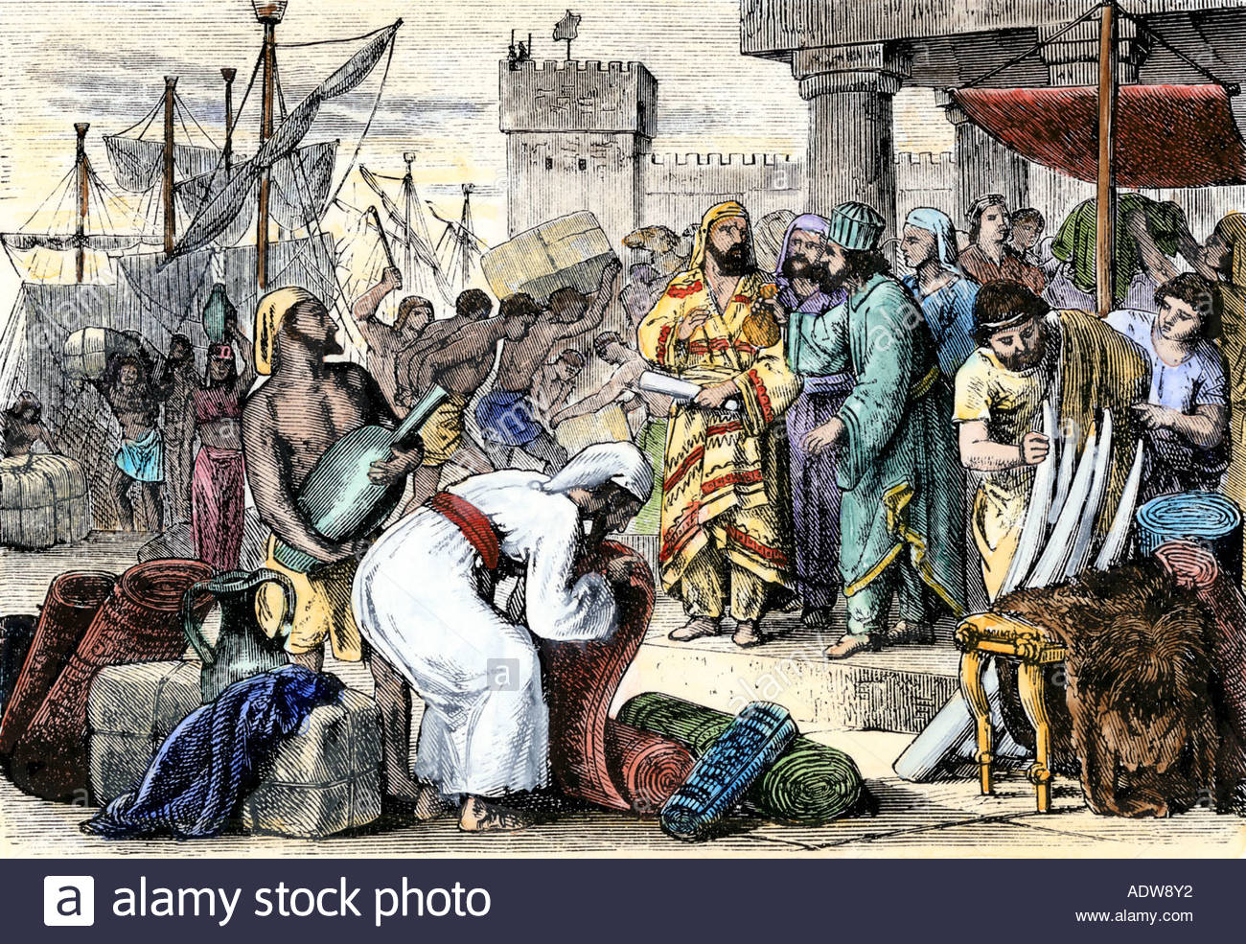

Slide 15
A System of Writing
A means by which people are able to record their ideas, thoughts, information, and knowledge so that it can be passed on to future generations (increasing collective learning.
Recording knowledge and information in order to increase collective learning.

Slide 16
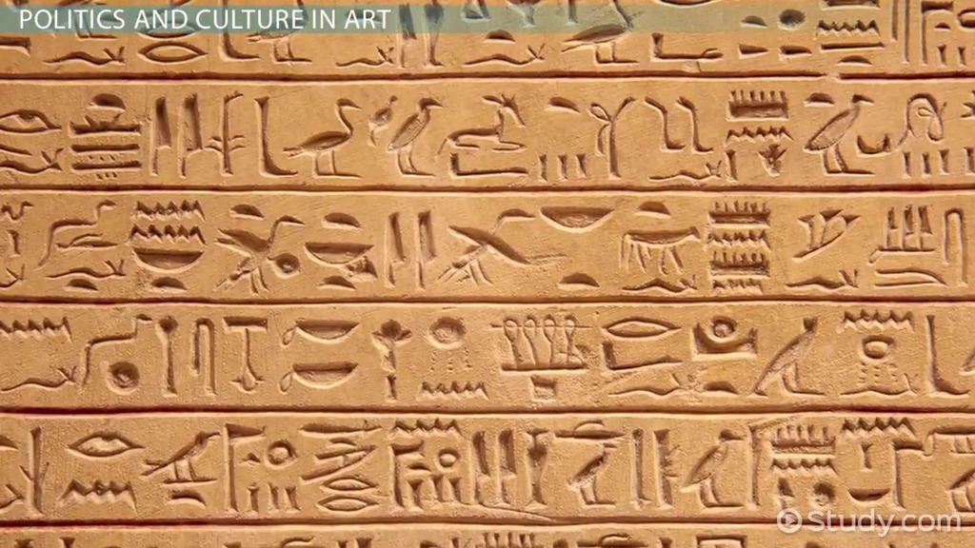

Slide 17
Expansion of Territory:
The act of taking over areas of land by means of migration, warfare, or diplomacy.
Taking other people’s stuff.

Slide 18
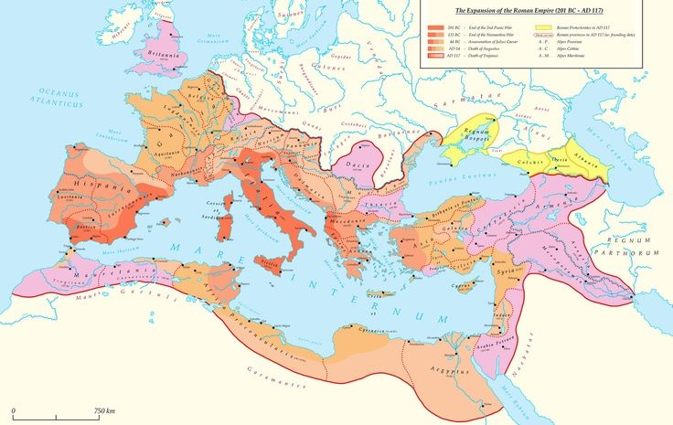

Slide 19
Monumental Architecture
Large scale building projects requiring massive amounts of labor and materials, aimed at showing the power and wealth of an individual and/or civilization.
Huge building projects that cost a lot, but ultimately show the greatness of a king or civilization.

Slide 20
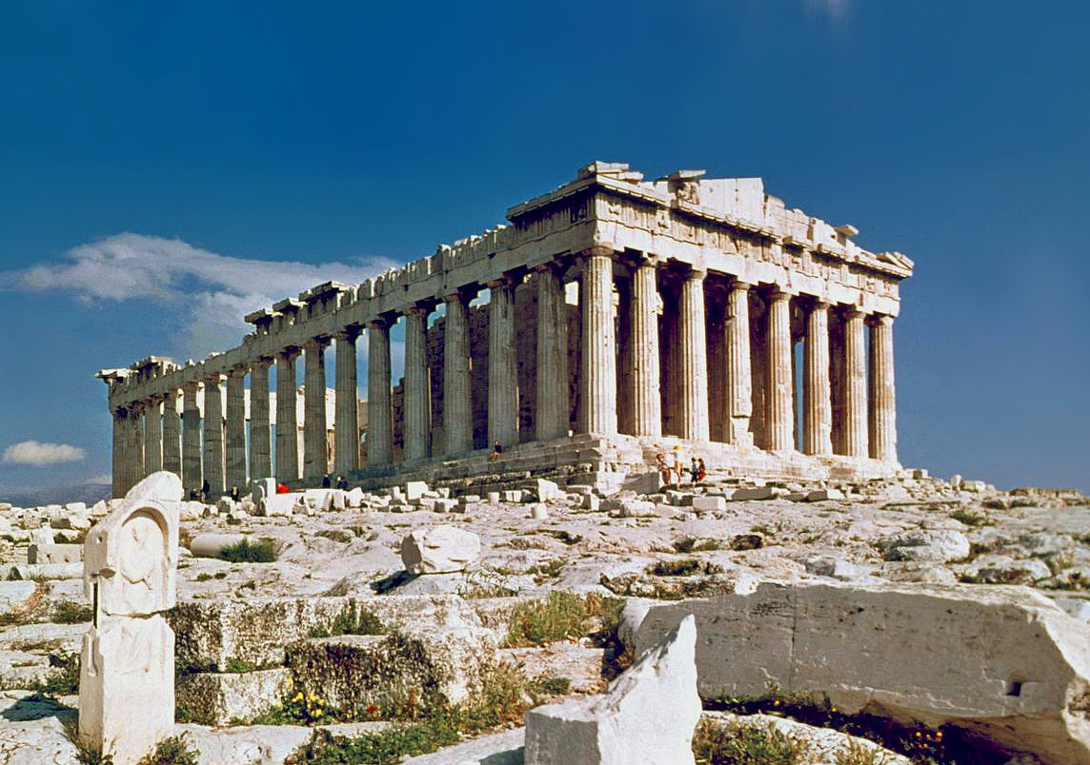

Slide 21
Increased Gender Inequality (Patriarchy)
Placing more importance on one gender over the other. In this case, males were seen as being superior to females, and came to dominate all aspects of public and private life.
Males were seen as more important than females and controlled all aspects of the civilization.

Slide 22
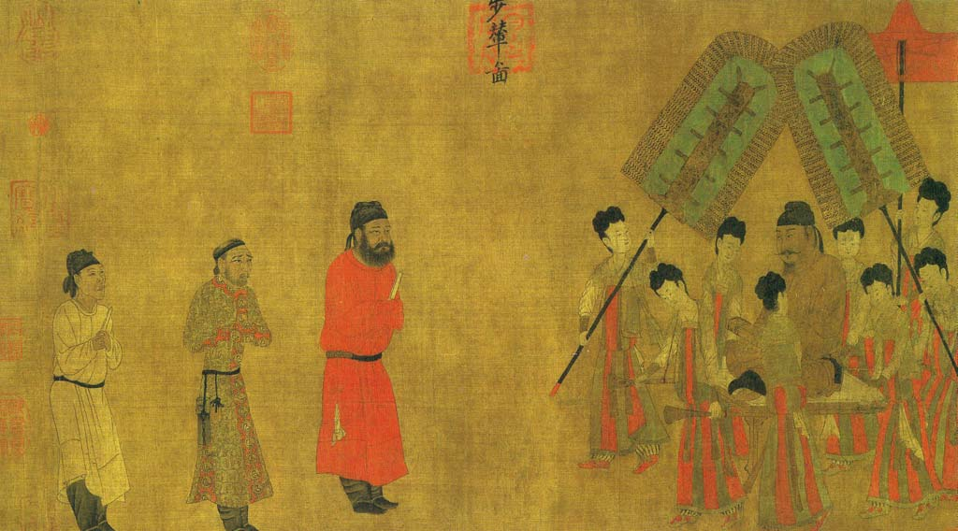

Slide 23
Achievements & Inventions:
The generation of a new idea, method, or product that greatly improves the way of life for a group or groups of people.
New ideas that make life easier.

Slide 24
