Slide 1
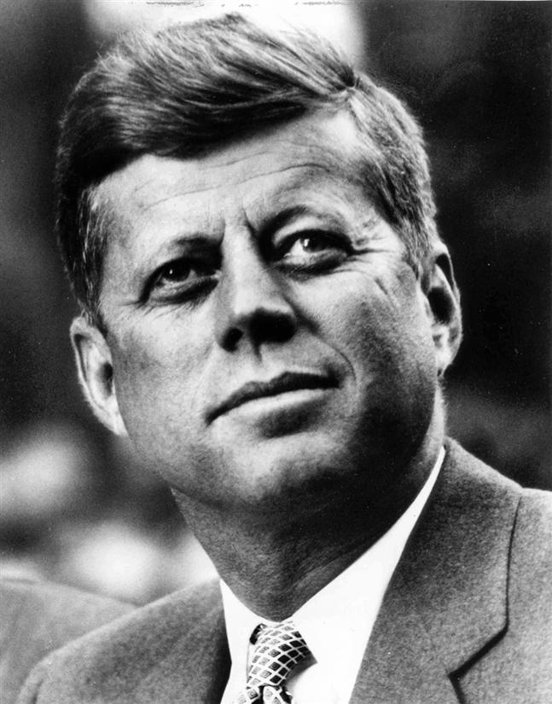
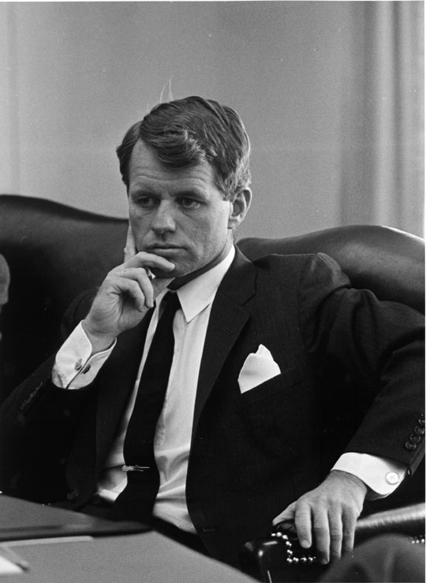
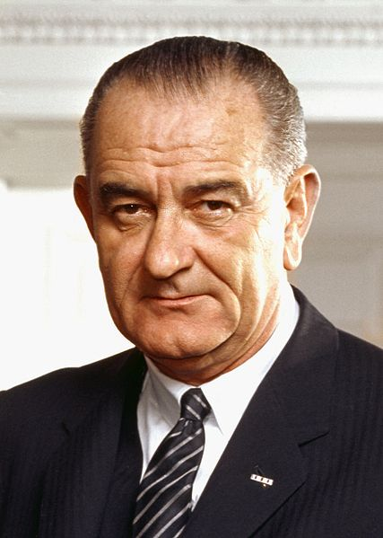
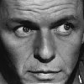
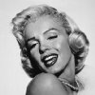
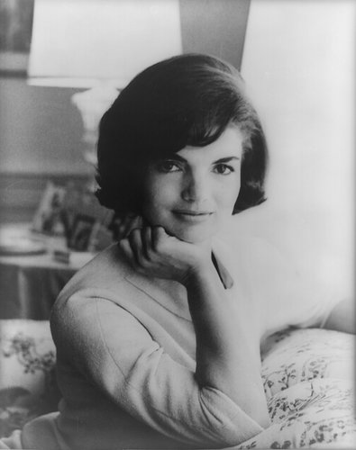
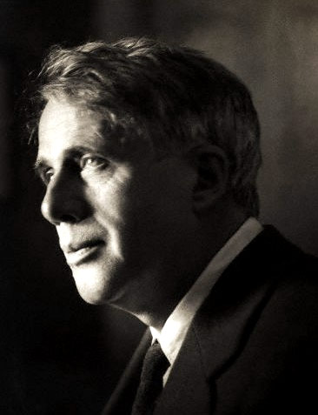
facebook
Wall
Photos
Flair
Boxes
Your Element
Logout
Your Element is currently
Wall
Info
Photos
Boxes
Write something…
Share
View photos of Your Element (5)
Send Your Element a message
John F. Kennedy is preparing to sign the Nuclear Test Ban Treaty
October 7, 1963
Poke message
Bobby Kennedy to John F. Kennedy Have you finalized your plans for the Texas trip?
October 1, 1963
Information
Networks:
Birthday:
Political:
Religion:
Hometown:
.
John F. Kennedy I can’t believe I had to actually send the National Guard to Alabama just so some kids could go to college!
June 11, 1963
John F. Kennedy is so glad we avoided war with the Russians! That Crisis in Cuba had my blood boiling!
October 28, 1962
Friends
John F. Kennedy hopes everyone realizes how serious I am about putting a man on the moon!!!
September 9, 1962
LBJ
Frank
Marilyn
John F. Kennedy wishes the Bay of Pigs invasion had gone better! I think Castro is going to be a major thorn in the side of the U.S.
April 17, 1961
Bobby
Jackie
Robert

Slide 2
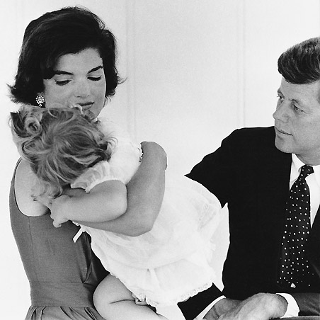
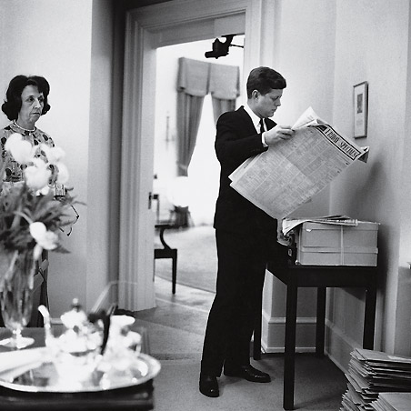
facebook
Wall
Photos
Flair
Boxes
Your Element
Logout
Your Element is currently…….
Wall
Info
Photos
Boxes
Basic Information
Networks:
Sex:
Birthday:
Hometown:
Relationship Status:
Political Views:
Religious Views:
View photos of Your Element (5)
Send Your Element a message
Poke message
Personal Information
Information
Activities:
Interests:
Favorite Music:
Favorite Movies:
Favorite TV Shows:
Favorite Books:
About Me Physically
About Me Chemically
Networks:
Birthday:
Political:
Religion:
Hometown:
Broo
Photos
Contact Information
2 Albums
Address:
Phone Number:
Education:
Work:
The Family
Updated last Tuesday
White House
Updated two months ago

Slide 3
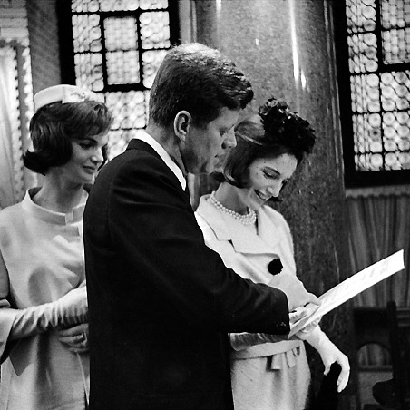
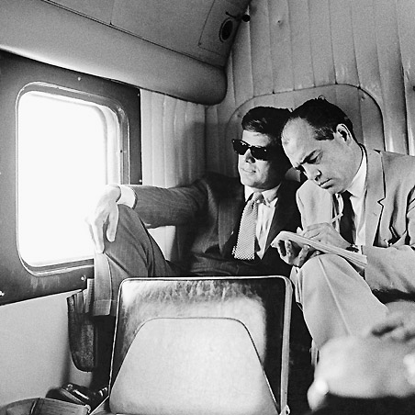
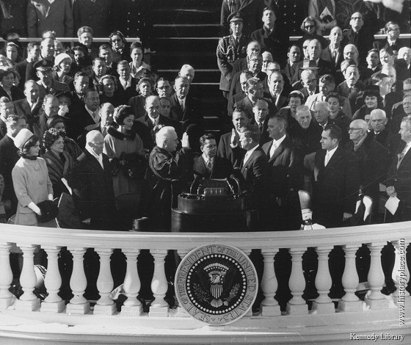
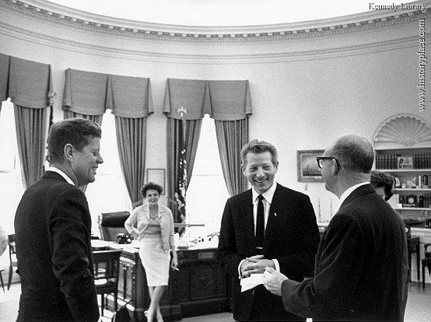
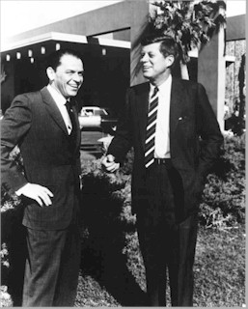
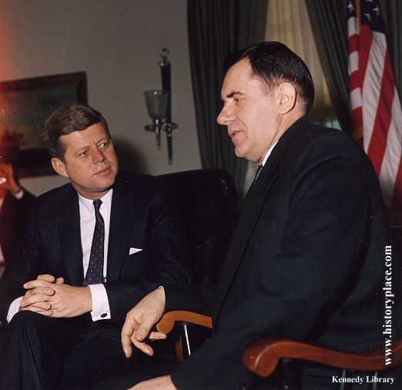
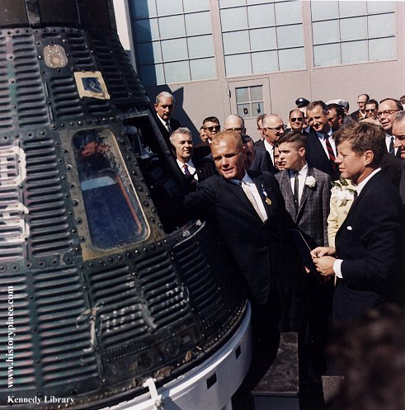
facebook
Wall
Photos
Flair
Boxes
Your Element
Logout
Your Element is currently
Wall
Info
Photos
Boxes
Photos of Your Element 7 Photos
Your Element 2 Photo Alums
The Family
5 photos
The White House
5 photos
Profile Pictures
1 photo

Slide 4
Mother Teresa
Founded the Missionaries of Charity in Calcutta, India, 1950
1979 – won Nobel peace Prize
1980 – Awarded Bharat Ratna in India
1928 – Joined the Sisters of Loreto as a missionary
1952 – Opened the Kalighat Home for the Dying
1955 – Opened the Nirmala Shishu Bivhan for orphans and homeless children
1982 – Negotiated a cease-fire between Israeli and Palestine armies to rescue 37 children from a devastated hospital
1991 – Opened Missionaries for Charity Brothers in Albania
1983 – Suffered heart attack while visiting Pope John Paul II in Rome

