Slide 1
Egyptian Mythology
By Some Ancient Egyptian

Slide 2
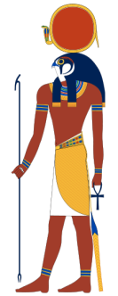
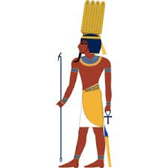
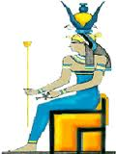
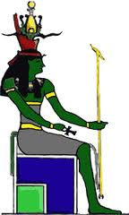
Mummification & The Afterlife
Ra
In the beginning there was the all-powerful god, Ra. He made the other gods: Shu-the winds that blew, Tefnut-the rain that fell, Geb-the earth, and Nut-the sky goddess. And Ra also made the god hapi-the River Nile that flowed and made Egypt fertile. Then Ra made all things on earth and he also made humans. Ra ruled as pharaoh for thousands of years, and it was such a time of goodness and plenty that people spoke of it fondly forever after.
Shu
Hapi
Nut
Geb
Tefnut

Slide 3
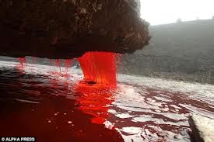
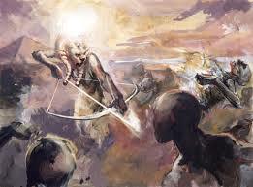
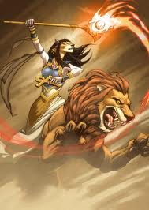
Mummification & The Afterlife
The Myth of Ra
But it came to pass that Ra grew old, and people no longer feared or obeyed him. So Ra became angry and summoned all the other gods to him. They advised him, "send destruction upon humankind and turn your Eye against them." So Ra sent his Eye against them, in the form of his daughter Sekhmet, the fiercest and most terrible of all the goddesses. Like a lion rushing upon its prey, she fell upon the people of Upper and Lower Egypt and slew all those who had disobeyed her father, Ra. She killed everyone she saw and rejoiced in the slaughter, delighting in the taste of blood.

Slide 4
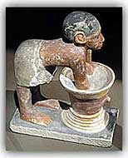
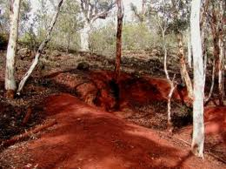
Mummification & The Afterlife
The Myth of Ra
The Nile itself ran red with blood, and eventually Ra felt sorry for the people, but even he couldn't stop Sekhmet's bloodthirsty rampage, so carried away was she with her terrible cruelty. Ra realized he would have to trick Sekhmet into stopping, so he ordered messengers to take red ochre from the isle of Elephantine and then bring it to him in the town of Heliopolis, where the women had been brewing beer all day long at Ra's command. The red ochre was mixed with seven thousand jars of beer and then poured out over the land where Sekhmet was planning her next slaughter.
Statue of Egyptian Preparing Beer
Red Ochre

Slide 5
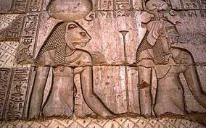
Mummification & The Afterlife
The Myth of Ra
When the sun rose the next day, Sekhmet saw the ground all flooded with the red beer, and, thinking it was the blood of those she had killed, she laughed with joy and drank deeply of it. She drank so much that the strength of the beer made her powerless. She could no longer slay, but instead she slept the day away and then staggered back to her father. Ra said, "You come in peace, sweet one," and from that moment onwards she became the goddess Hathor, as sweet and strong as love itself. Each new year afterwards, the priestesses of Hathor drank the beer of Heliopolis colored with red ochre from Elephantine to celebrate her festival.
Carving showing Sekhmet becoming Hathor

Slide 6
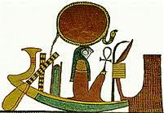
Mummification & The Afterlife
The Myth of Ra
Ra continued to rule, but he was growing old and losing his wisdom. None of the other gods could take his wisdom as they didn't know his secret name of power. But then Geb and Nut had children, and the younger gods and goddesses were born: Osiris, Isis, Seth, and Nephthys. Isis was the wisest of these four, and she managed to trick Ra into telling her his secret name of power. From that time on, Ra was pharaoh no longer but took his place in the heavens, travelling across the sky each day and crossing the underworld each night in the Boat of Ra, taking with him the souls of the dead.

Slide 7
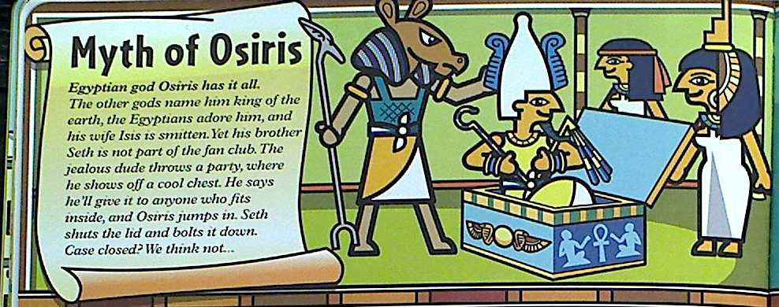
Mummification & The Afterlife
The Myth of Osiris
The Egyptian god Osiris had it all. The other gods named him king of the earth, the Egyptians adored him, and he was married to the beautiful goddess Isis. Yet, his brother, Seth, was not part of his fan club. The jealous brother threw a party where he showed off a beautiful chest that he said he would give away to anyone who fit inside. As Osiris began to climb into the chest, Seth slammed the lid shut and bolted it down.

Slide 8
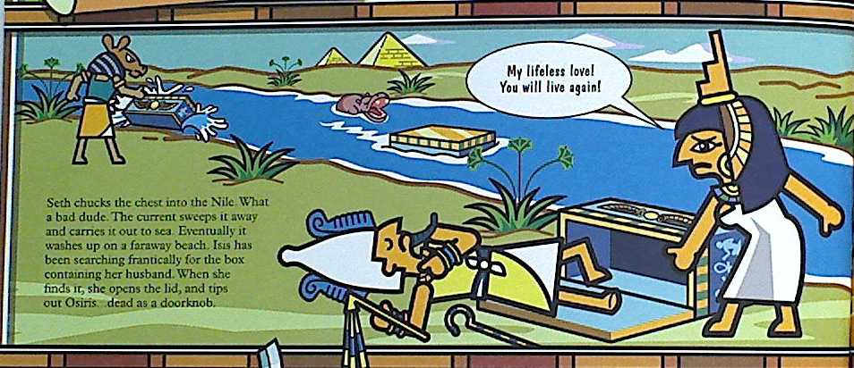
Mummification & The Afterlife
The Myth of Osiris
Seth then chucked the chest into the Nile River. The current swept it away and carried it out to sea. Eventually it washed up on a faraway beach. Isis had been searching frantically for the box containing her husband. When she finally found it, she opened the lid, and out rolled Osiris, dead.

Slide 9
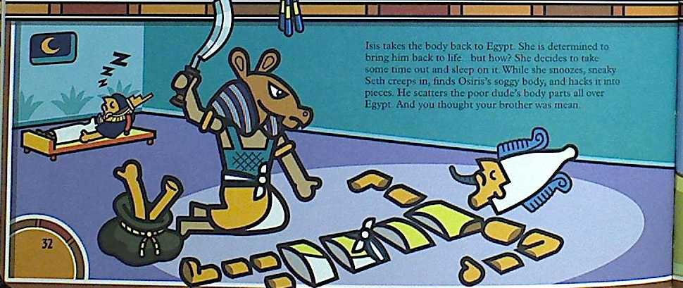
Mummification & The Afterlife
The Myth of Osiris
Isis took the body back to Egypt. She was determined to bring him back to life, but the question what "How"? She decided to take some time out and get some rest. While Isis was sleeping, Seth crept into the palace and hacked Osiris into a thousand pieces. he then scattered Osiris' body throughout all of Egypt.

Slide 10
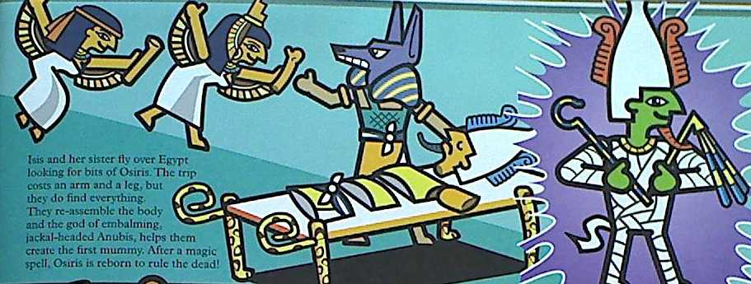
Mummification & The Afterlife
The Myth of Osiris
Isis and her sister, Nephthys, flew all over Egypt looking for the bits of Osiris' body. The trip took forever, but finally they found all of Osiris. They reassemble the body and the god of embalming, Anubis, helped them create the world's first mummy. After a magic spell, Osiris is reborn to rule the dead.

Slide 11
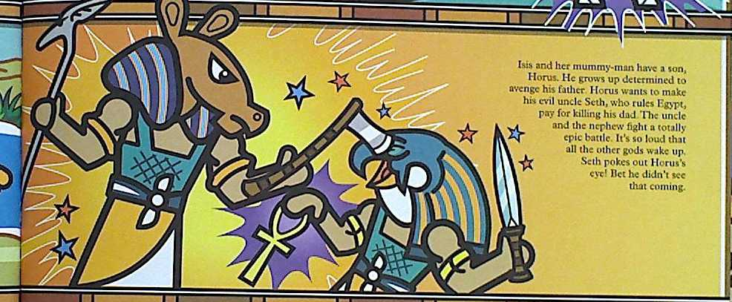
Mummification & The Afterlife
The Myth of Osiris
Isis and her mummy-man have a son, Horus. He grows up determined to avenge his father. Horus wants to make his evil uncle Seth, who rules Egypt, pay for killing his father. The uncle and the nephew fight an epic battle. It is so loud that all of the other gods are awakened. At one point (no pun intended) Seth pokes out Horus' eye.

Slide 12
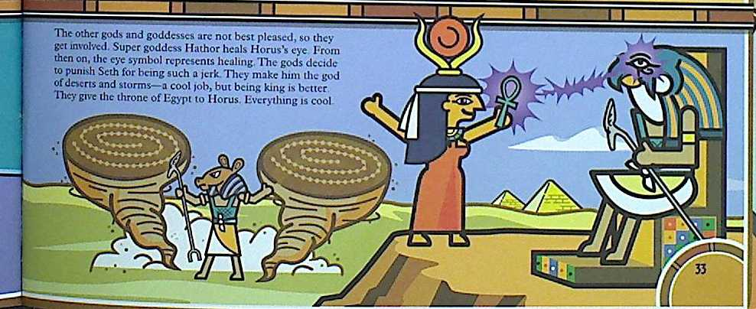
Mummification & The Afterlife
The Myth of Osiris
The other gods and goddesses are not pleased, so they get involved. The goddess Hathor, heals Horus' eye. From then on, the eye is the symbol representing healing. The gods decide to punish Seth and make him the god of desert storms. They give the throne of Egypt to Horus, who eventually shares it with the pharaohs.

Slide 13
Mummification & The Afterlife
Mini-Assignment: For this assignment, you are going to create a graphic novel (comic book) about the myth of Ra and the myth of Osiris. Each of your graphic novels should contain the following:
A title that identifies which myth you are writing about.
A summary of each of the myths that highlights all of the important facts and events.
A picture or drawing for each important fact and event.
Be sure to have plenty of bright, bold color.

