Slide 1
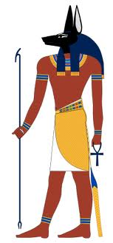
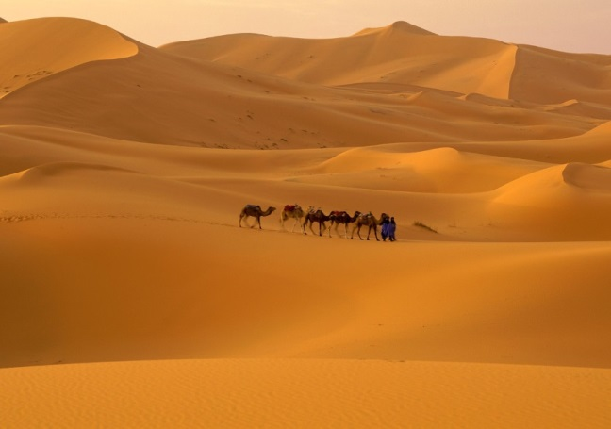
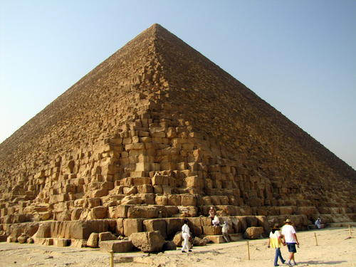
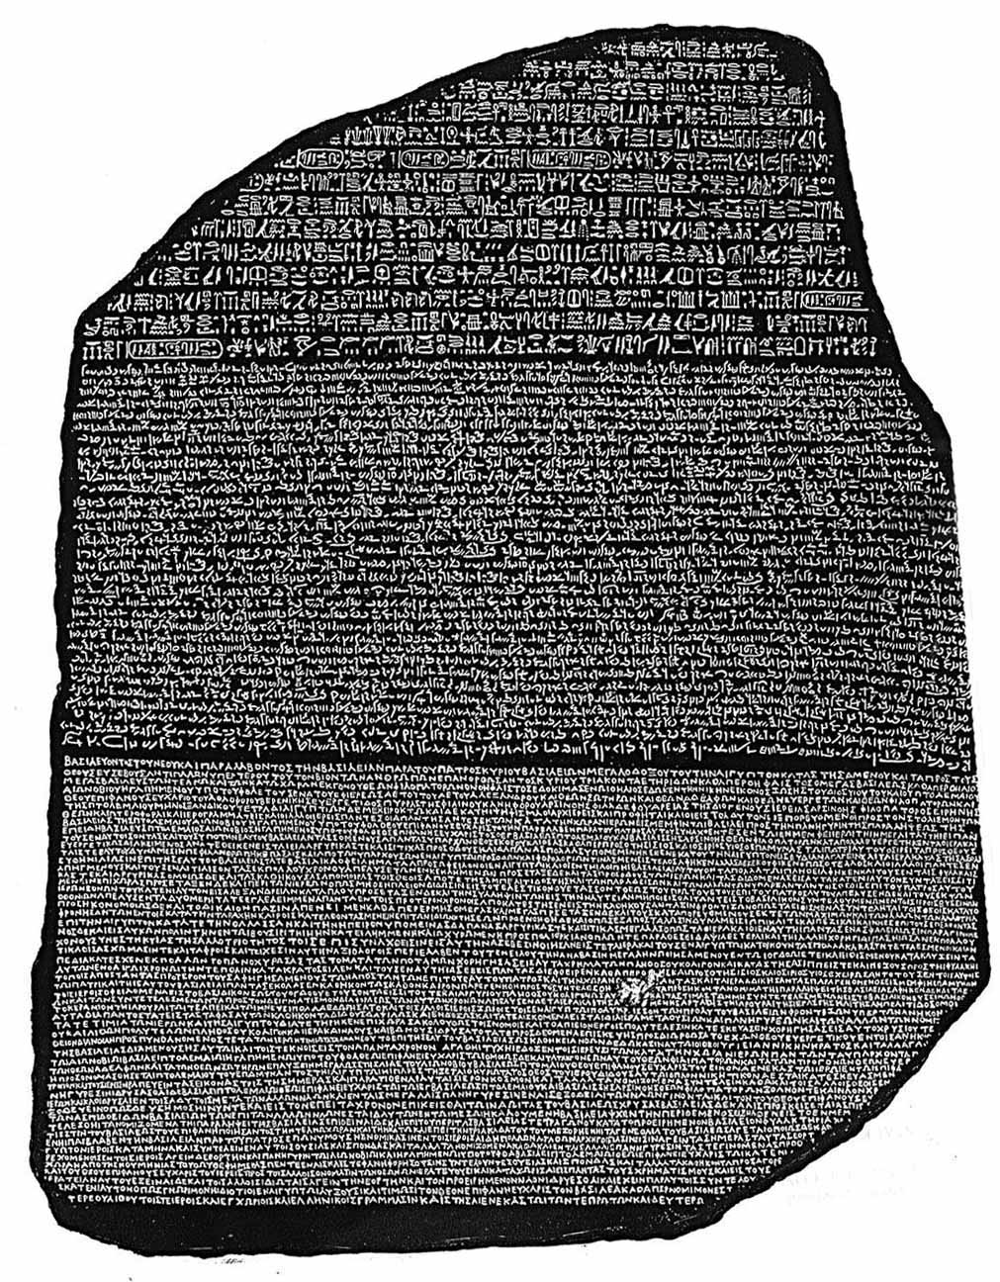
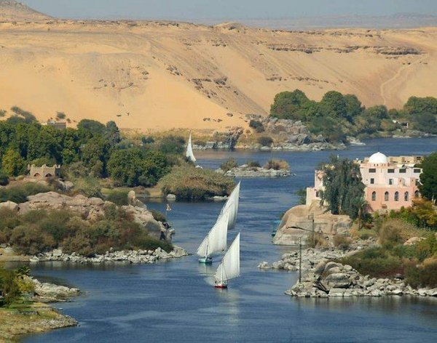
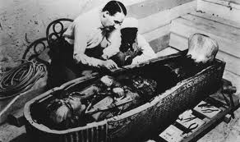
Ancient Egypt: A Journey into the Past

Slide 2
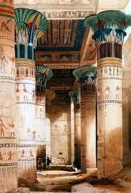
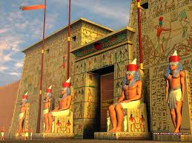
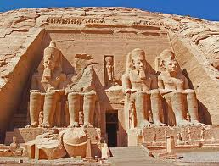
Religion of Ancient Egypt
Egyptians were polytheistic. They had a great number of gods - one source lists 740. Only a small number were worshipped by all Egyptians at the same time. Most gods changed their character over the centuries; as new gods were accepted, they sometimes blended with old gods. Temples were dedicated to certain gods. A temple was the palace of the god and everyday priests would perform elaborate rituals and offer prayers and sacrifices to the gods. Ordinary people did not participate in these rituals, but they did participate in the festivals honoring the gods.

Slide 3
Gods & Goddesses of Ancient Egypt
The Egyptians had a wide and varied mythology that rivaled that of the Greeks and Romans. Within this mythology, there were a cast of characters that watched over all aspects of Egyptian culture.

Slide 4
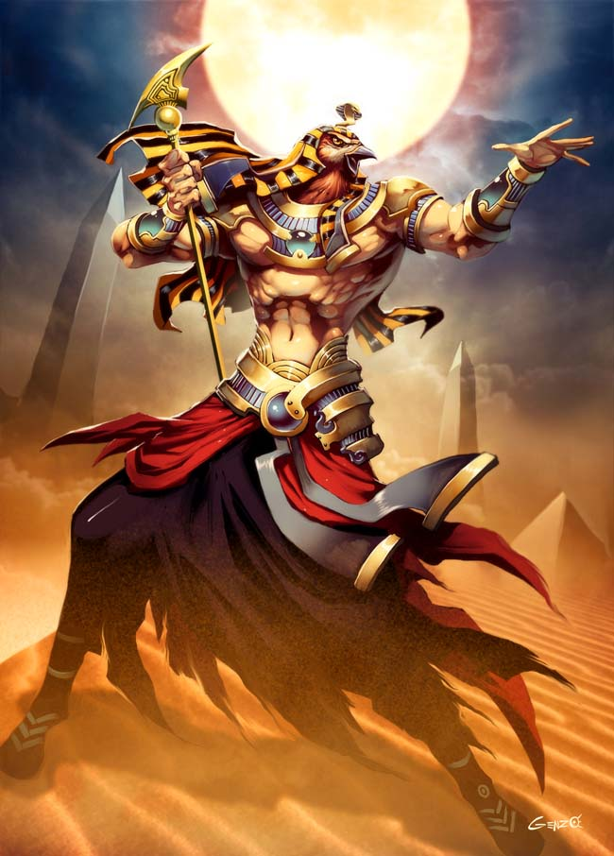
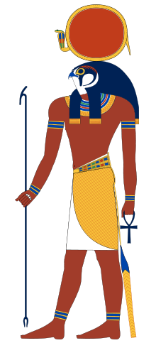
Gods & Goddesses of Ancient Egypt
Ra: The Sun God. Considered the King of the Gods.

Slide 5
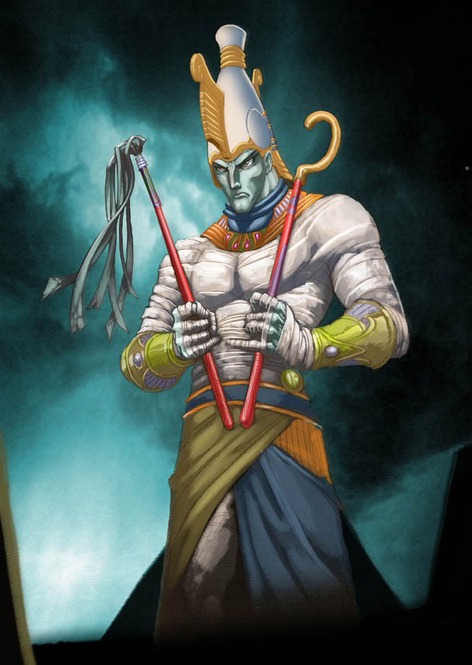
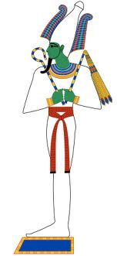
Gods & Goddesses of Ancient Egypt
Osiris: God of Agriculture & Ruler of the Dead

Slide 6
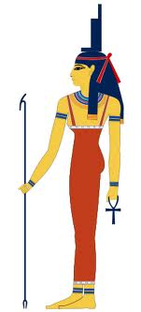
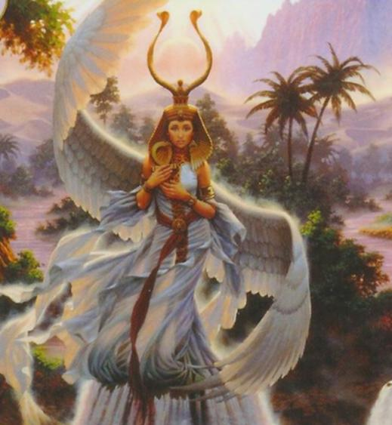
Gods & Goddesses of Ancient Egypt
Isis: wife of Osiris and mother of Horus. She was the protector of children.

Slide 7
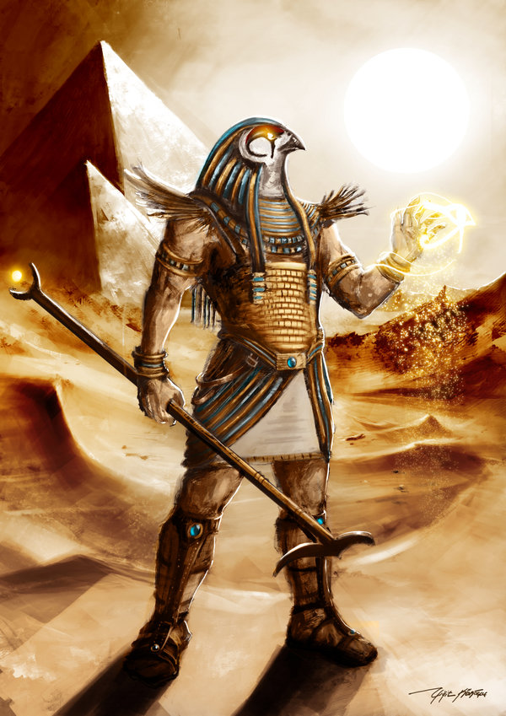
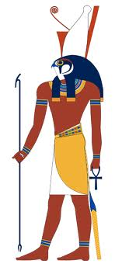
Gods & Goddesses of Ancient Egypt
Horus: son of Osiris and Isis. He is the god of the sky and the Pharaoh is associated with him during his lifetime.

Slide 8
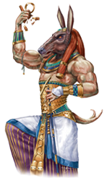
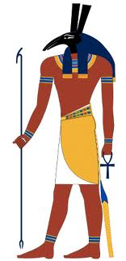
Gods & Goddesses of Ancient Egypt
Seth: Brother of Osiris and god of desert storms.

Slide 9
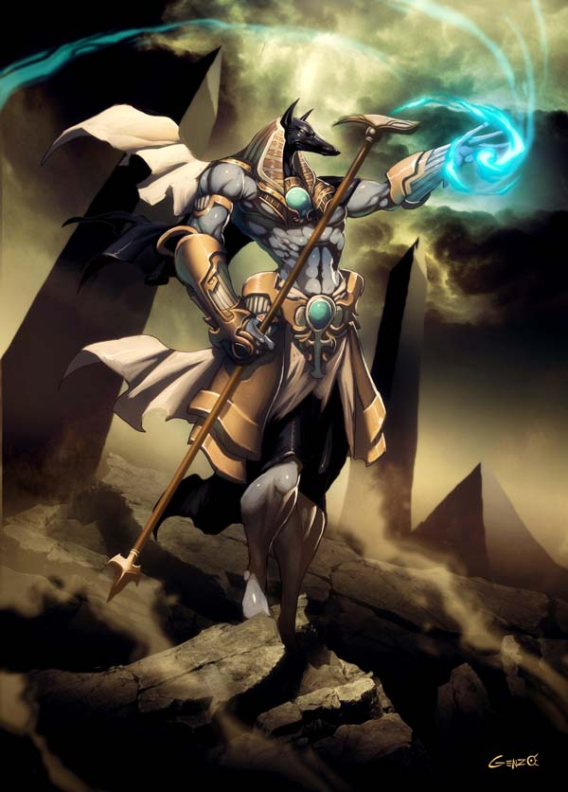
Gods & Goddesses of Ancient Egypt
Anubis: God of Embalming and the Weighing of the Heart Ceremony.

Slide 10
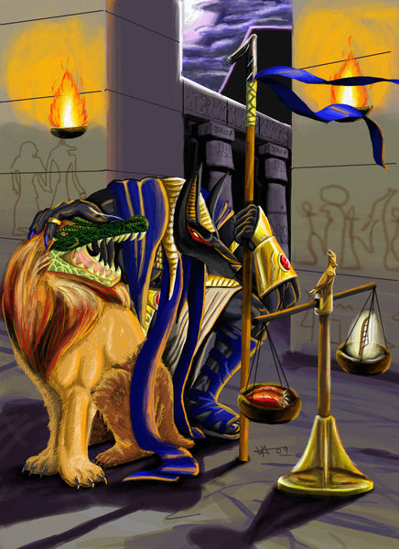
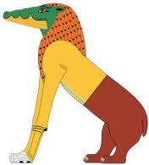
Gods & Goddesses of Ancient Egypt
Ammit: Demon-like creature that devoured your heart if it was heavier than the feather of truth.

Slide 11
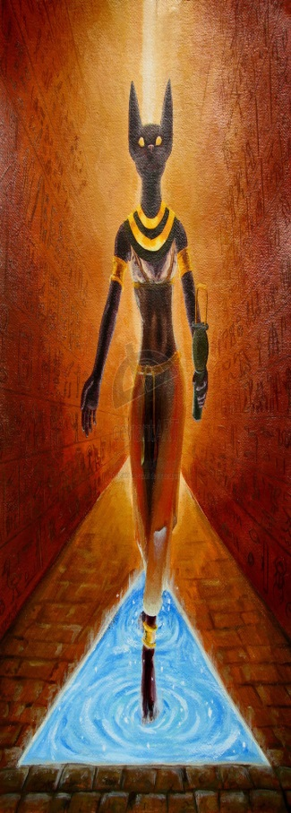
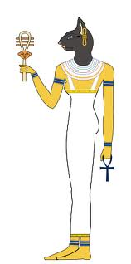
Gods & Goddesses of Ancient Egypt
Bastet: Goddess of Joy and Love.

Slide 12
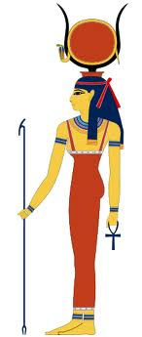
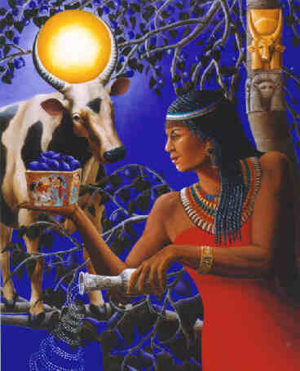
Gods & Goddesses of Ancient Egypt
Hathor: Goddess of the sky. Associated with fertility, music, & dance.
Hathor: Goddess of the sky. Associated with fertility, music, & dance.

Slide 13
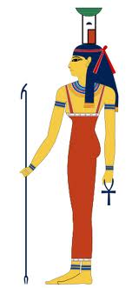
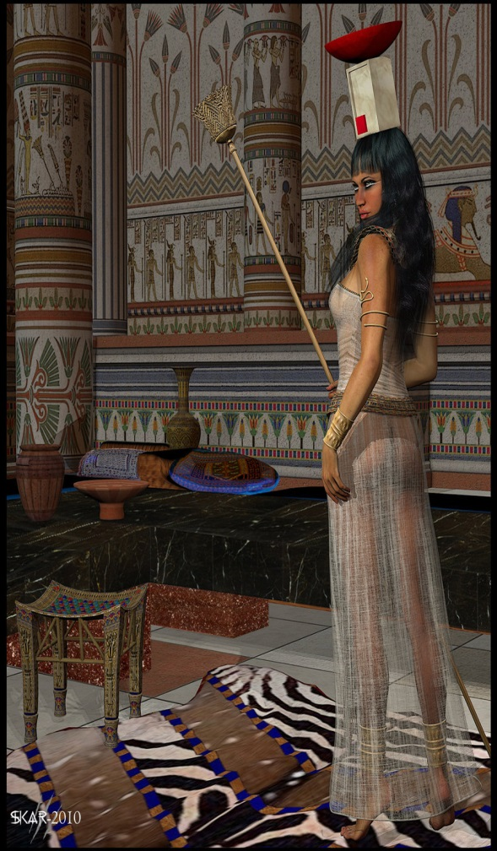
Gods & Goddesses of Ancient Egypt
Nephthys: Protector of women and friend of the dead.

Slide 14
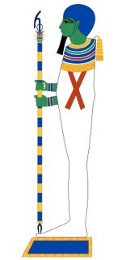
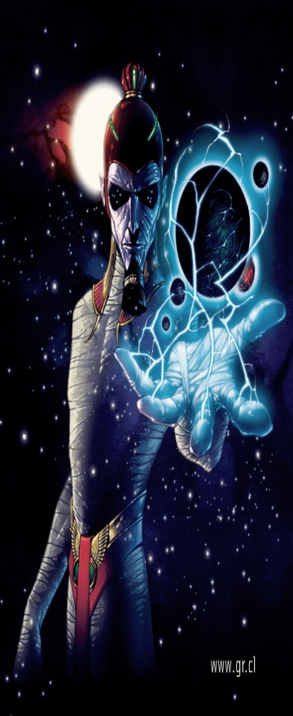
Gods & Goddesses of Ancient Egypt
Ptah: Originally the creator god. God of artists and craftsmen.

Slide 15
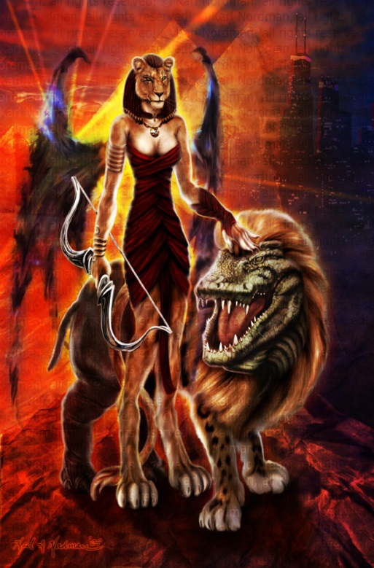
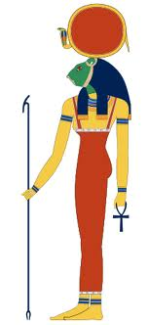
Gods & Goddesses of Ancient Egypt
Sekhmet: Warrior Goddess.

Slide 16
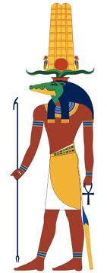
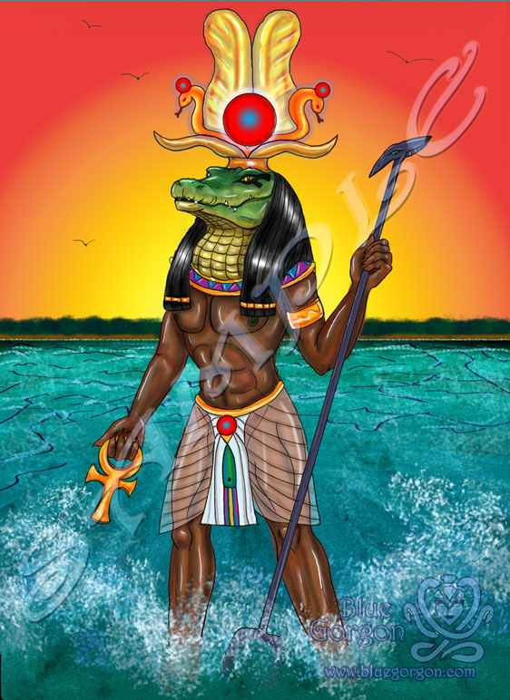
Gods & Goddesses of Ancient Egypt
Sobek: God of the Nile.

Slide 17
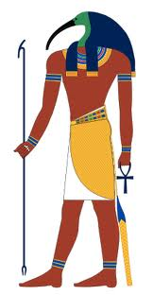
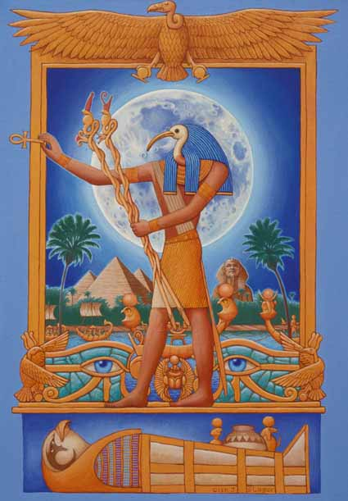
Gods & Goddesses of Ancient Egypt
Thoth: God of writing and wisdom.

Slide 18
Gods & Goddesses of Ancient Egypt
Mini-Assignment: For this assignment, you are going to create a series of trading cards for the various gods and goddesses of ancient Egypt. You should have a trading card for each of the following gods and goddesses: Ra, Osiris, Isis, Horus, Seth, Anubis, Ammit, Bastet, Hathor, Nephthys, Ptah, Sekhmet, Sobek, and Thoth. Each of the trading cards should contain the following:
The name of the god or goddess.
A title that explains what they are the god or goddess of.
A picture of the god or goddess.
A catchy slogan that reminds people what they are the god or goddess of.
Be sure to have plenty of bright, bold color.

