Slide 1
Pyramids & Tombs of Ancient Egypt
By Some Egyptian Guy

Slide 2
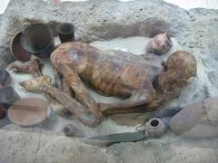
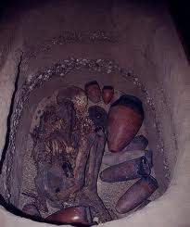
Pyramids & Tombs
The earliest burials took place in the deserts. Bodies were buried in pits directly in the desert sands. As time went on though, the wealthy and powerful upper classes wanted to be buried in places that suited their level in society.

Slide 3
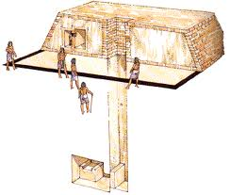
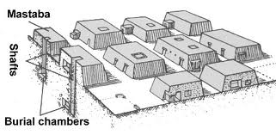
Pyramids & Tombs
Soon, the nobility began constructing mastabas, or flat-roofed tombs. These structures were made of stone or mud bricks, and were one of the main reasons why the Egyptians had to develop the process of mummification. Without the dry desert sand to naturally dry out the body, they needed to develop a man-made process that would prevent the body from decaying.

Slide 4
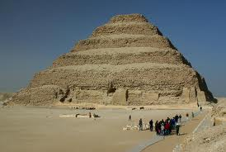
Pyramids & Tombs
As mastabas became more and more common among the upper classes, the pharaohs began to desire something more elaborate to show their supremacy as the rulers of Egypt. The first to do this was the pharaoh Zoser, whose architect, Imhotep, stacked mastabas on top of each other to create Egypt's first pyramid, the step pyramid.

Slide 5
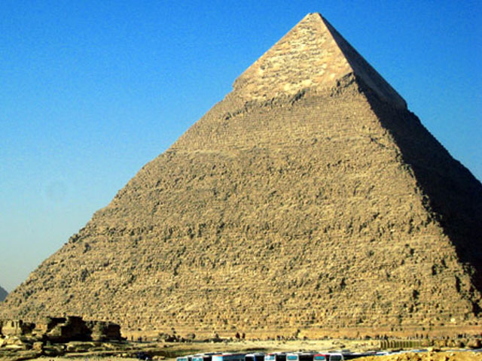
Pyramids & Tombs
As pyramid building became all the rage during the Old Kingdom, pharaohs continued to try to out do those that came before them. The pinnacle of pyramid building occurred with the Pharaoh Khufu, who constructed the iconic symbol of ancient Egypt, the Great Pyramid of Giza. But how did they build it?

Slide 6
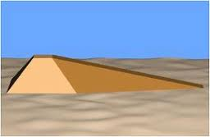
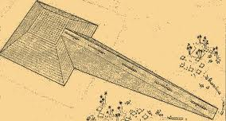
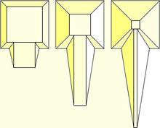
Pyramids & Tombs
There are three main theories for how the Egyptians built the pyramids.
Theory 1: Earthen Ramps
-Stones would have been dragged up huge ramps of earth and put in place. But such ramps would need vast amounts of earth to build.

Slide 7
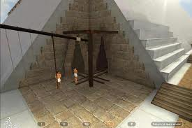
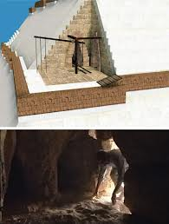
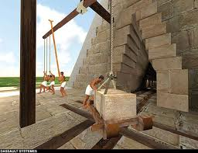
Pyramids & Tombs
Theory #2: Pulleys and Cranes
Enormous pulleys would have been built to hoist each stone into place. But these pulleys would need to be incredibly strong and tallto reach the top of the pyramid.

Slide 8
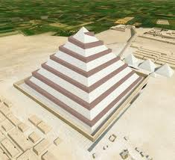
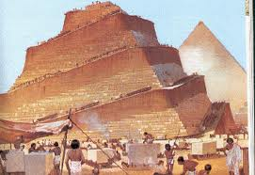
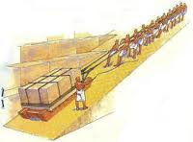
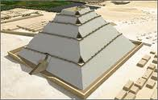
Pyramids & Tombs
Theory #3: Spiral Causeway
Pathways of mud brick would have been coilded around the edge of the pyramid and the stones pulled up on sledges.

Slide 9
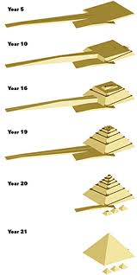
Pyramids & Tombs
Currently the most accepted theory is a combination of Theory #1 and Theory #3. Early into the construction, Egyptologists believe the Egyptians used large earthen ramps, but as they began to get higher up the pyramid, they switched to spiral ramps that wrapped around the entire pyramid. In the following pages, we will look at the step by step process of building the Great Pyramid.

Slide 10
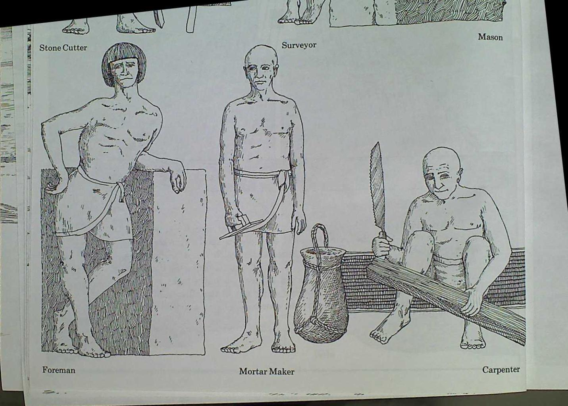
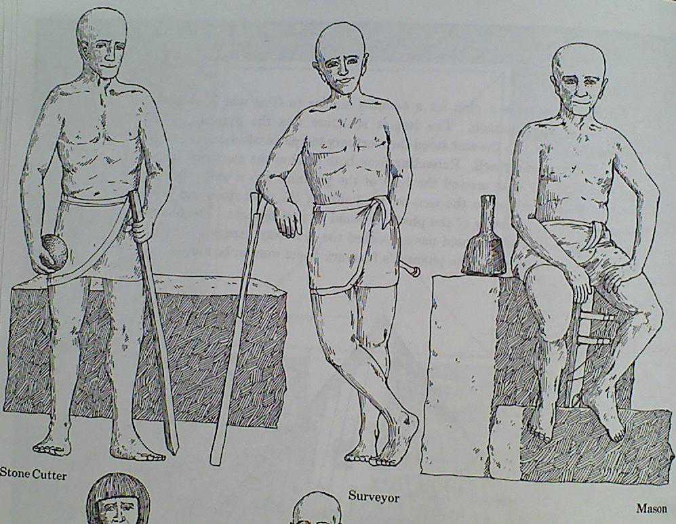
Pyramids & Tombs
First, men were conscripted from villages during the annual inundation.

Slide 11
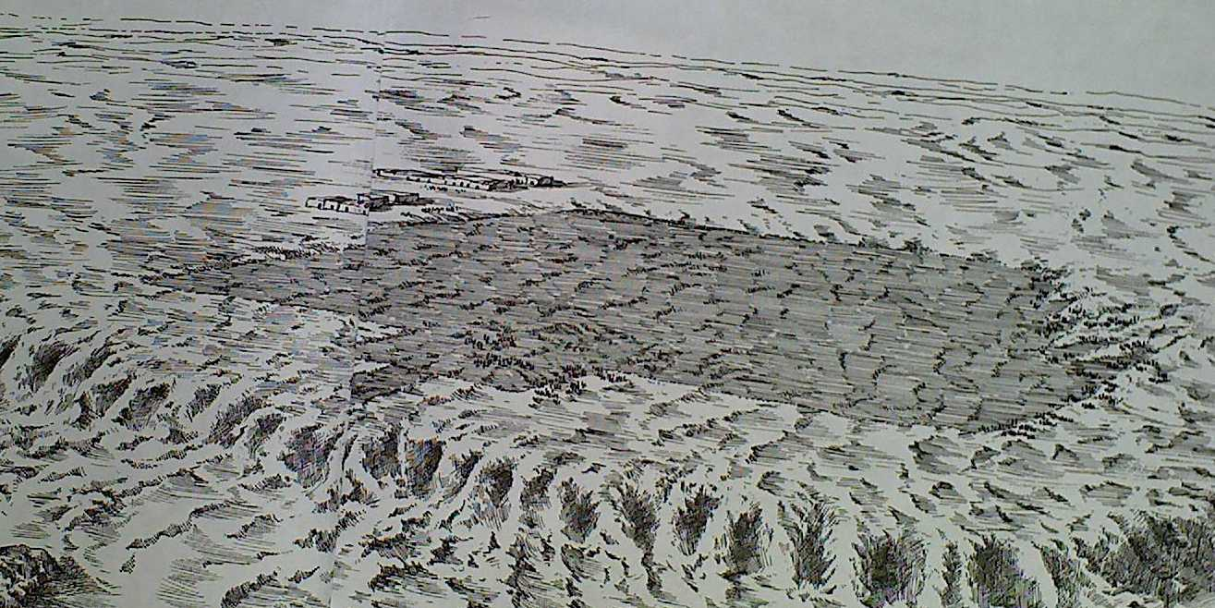
Pyramids & Tombs
The land was cleared and leveled.

Slide 12
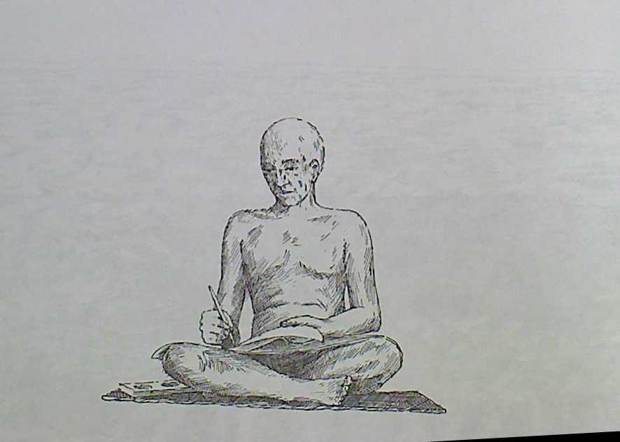
Pyramids & Tombs
Scribes prepared a list of necessary stones.

Slide 13
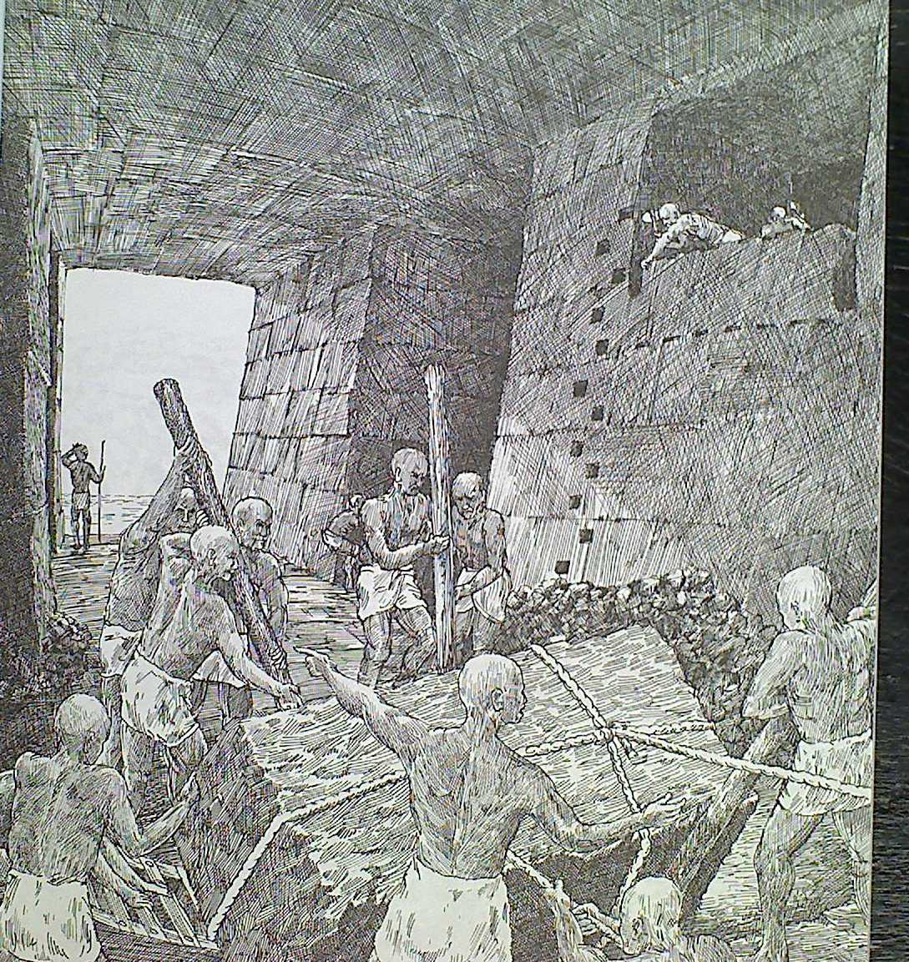
Pyramids & Tombs
Work orders and lists of stones were sent to the quarries.

Slide 14
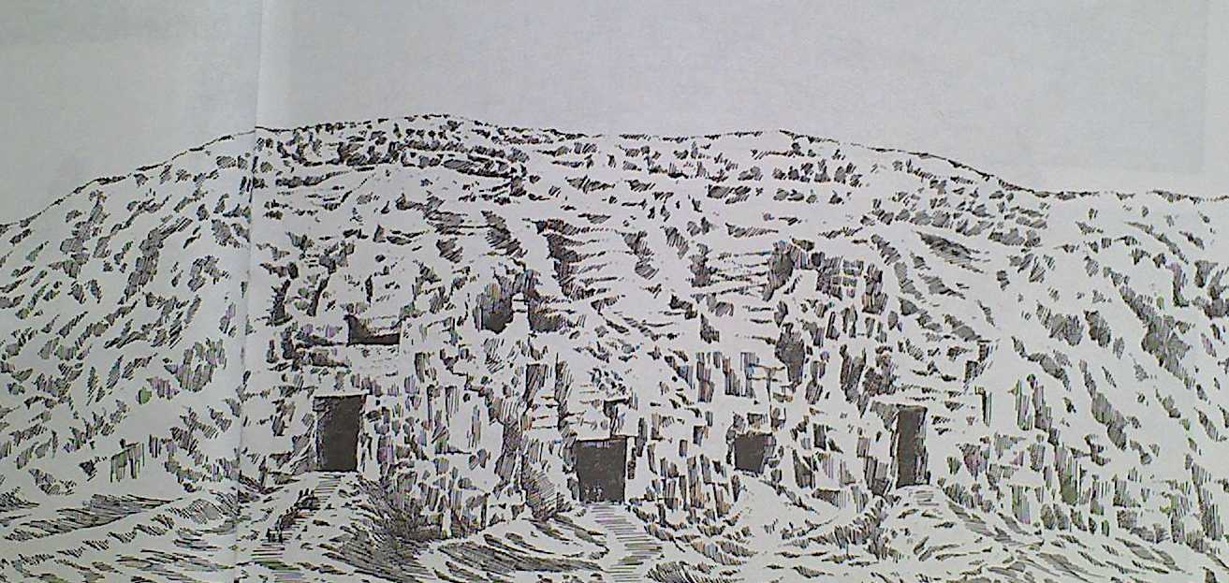
Pyramids & Tombs
Tunnels were dug into the face of the cliff.

Slide 15
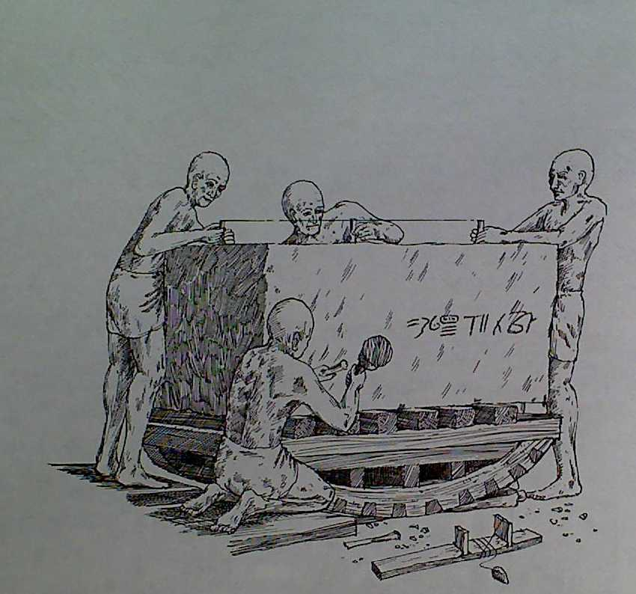
Pyramids & Tombs
Each block was cut and assigned to a work gang for delivery.

Slide 16
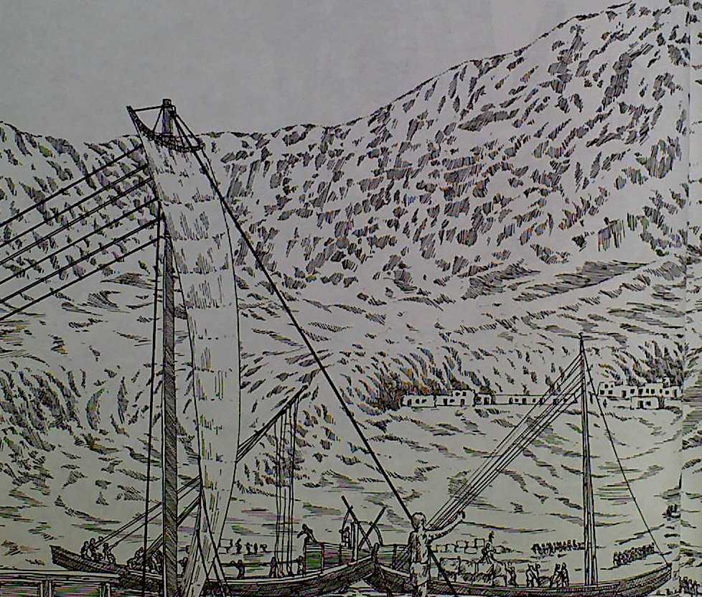
Pyramids & Tombs
The stone blocks were dragged to a waiting boat.

Slide 17
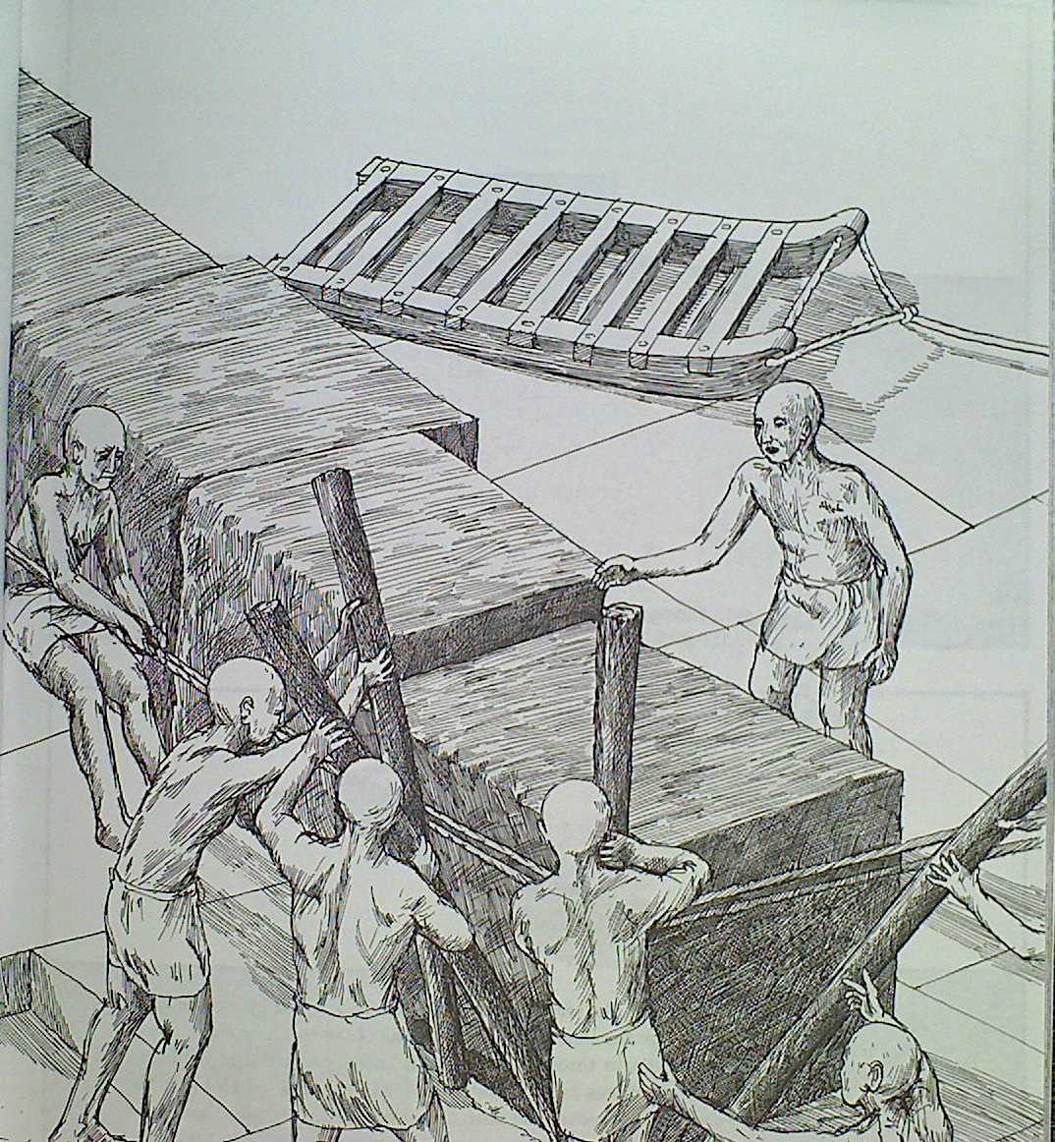
Pyramids & Tombs
The men rolled the stone blocks onto wooden sleds.

Slide 18
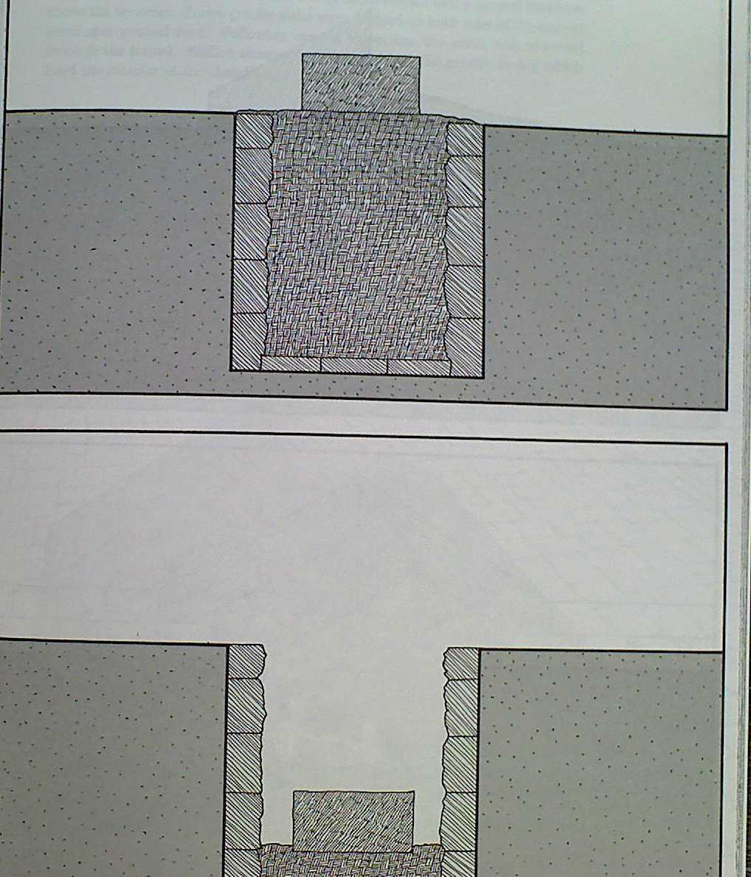
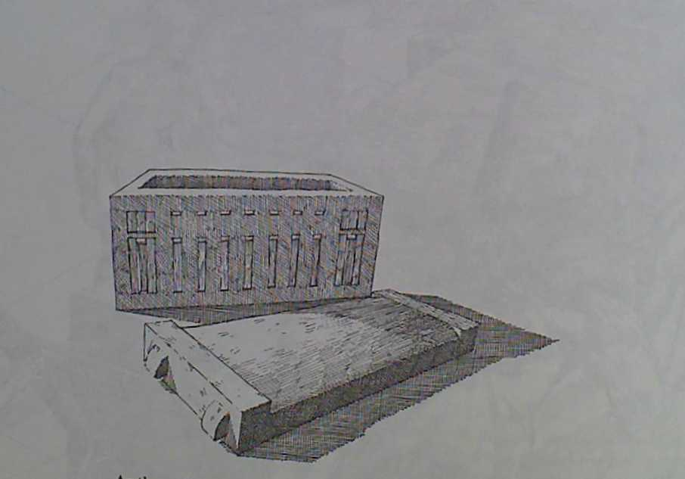
Pyramids & Tombs
The Sarcophagus was lowered into the tomb.

Slide 19
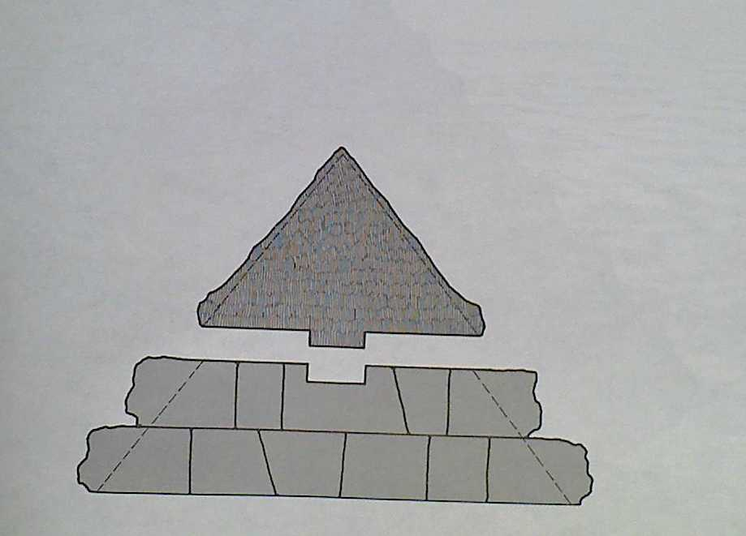
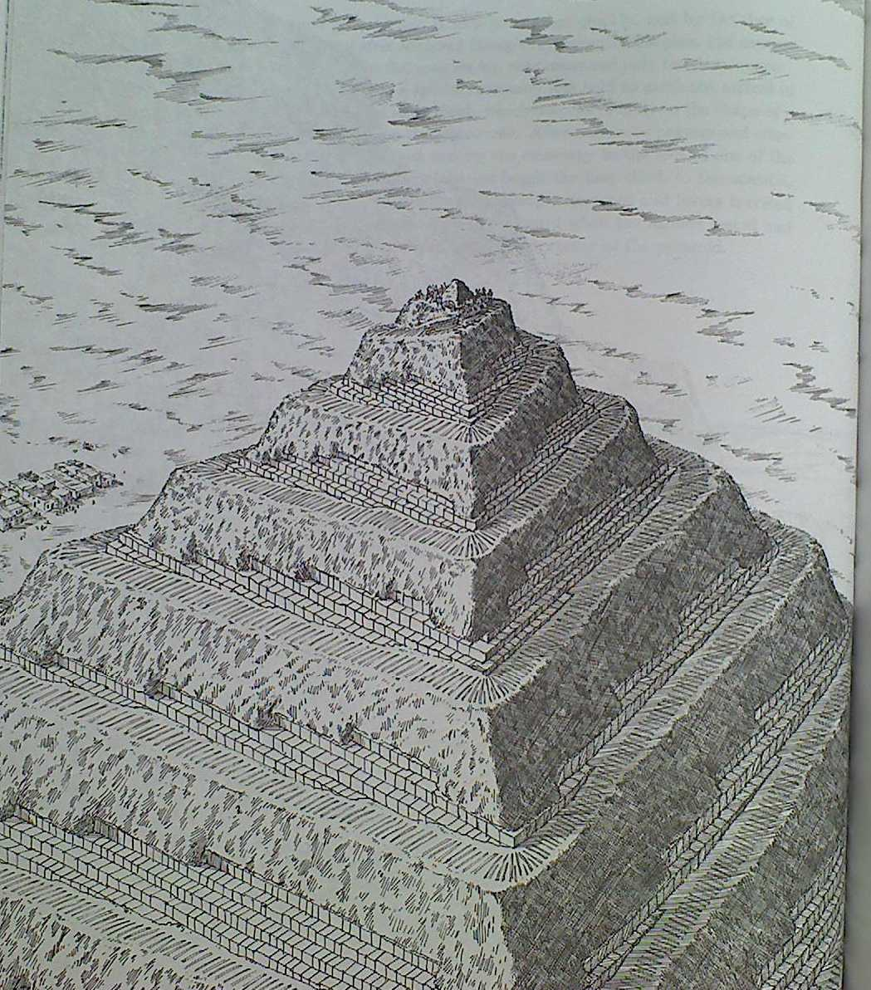
Pyramids & Tombs
The capstone was placed on top of the pyramid.

Slide 20
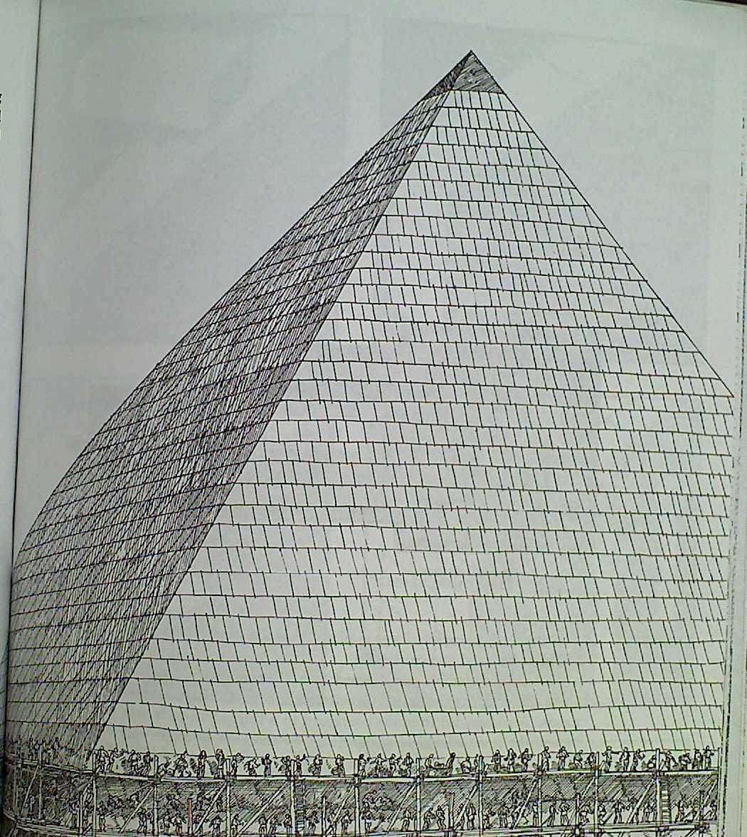
Pyramids & Tombs
Polished limestone blocks were placed on the outside of the pyramid.

Slide 21
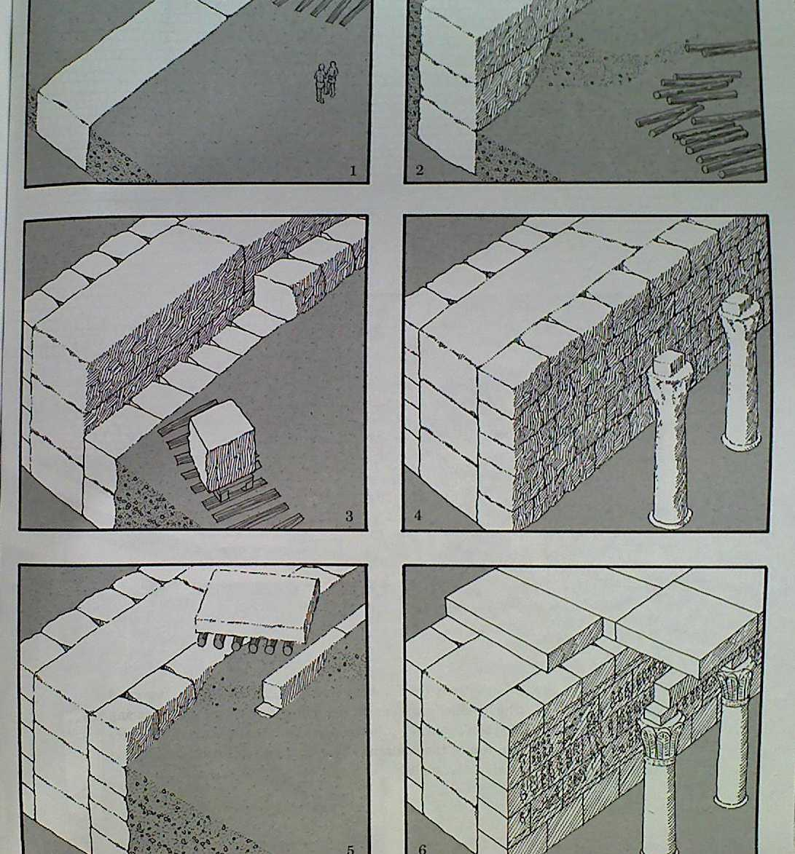
Pyramids & Tombs
The outer sanctuaries and temples were built.

Slide 22
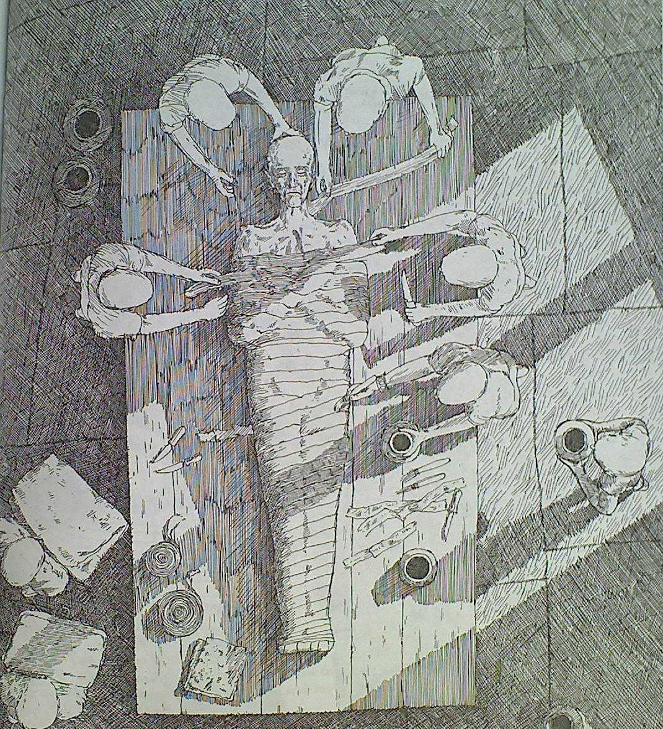
Pyramids & Tombs
The internal organs were removed and the body was packed in natron for 40 days.

Slide 23
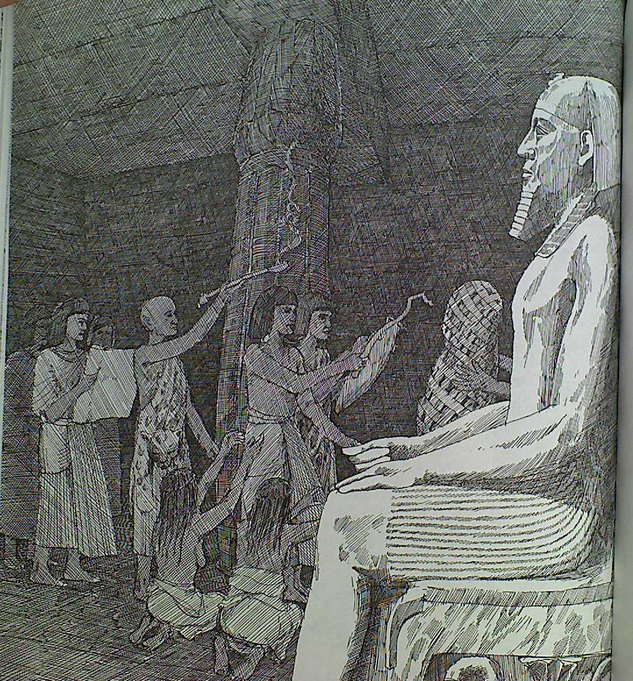
Pyramids & Tombs
The "Opening of the Mouth" ceremony was conducted.

Slide 24
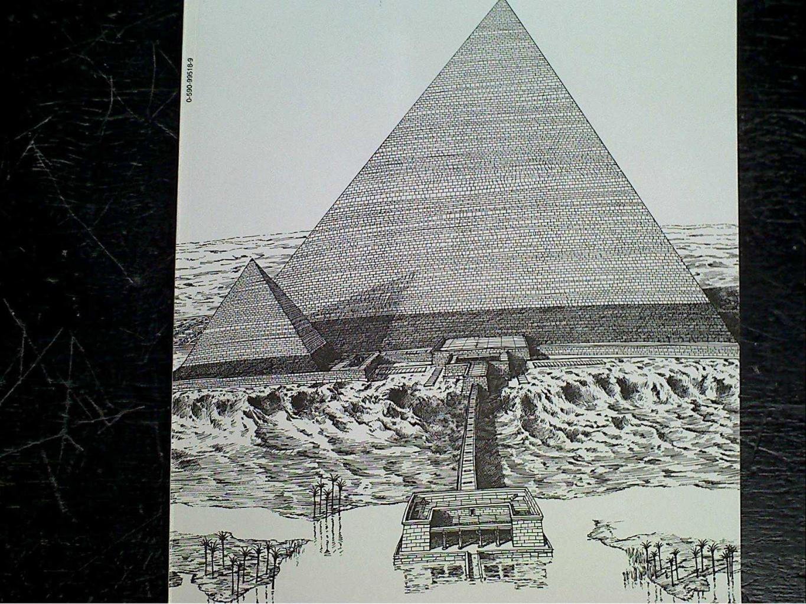
Pyramids & Tombs
The tomb was sealed.

Slide 25
Pyramids & Tombs
Mini-Assignment: For this assignment, you are going to create a short flipbook that correctly arranges the steps in the pyramid building process, and a picture for each one of the steps. Your first task is to put the following steps in order from start to finish:
Quarrymen use bronze chisels to prepare the stones.
The tomb and pyramid are sealed.
Ramps are taken down and the sides are chiseled smooth.
The Opening of the Mouth Ceremony is performed.
Farmers are conscripted from villages along the Nile River.
Masons complete final preparations for the stones to be laid.
The Pharaoh’s body is covered in natron for 40 day.
Workmen pull the stones up ramps on wooden sleds.
The land is cleared and leveled.
The capstone is placed on the top of the pyramid.
Be sure to have plenty of bright, bold color.

