Slide 1
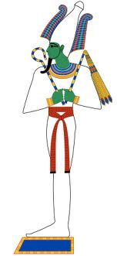
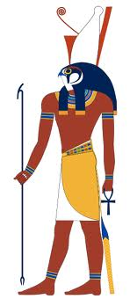
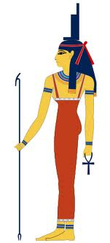
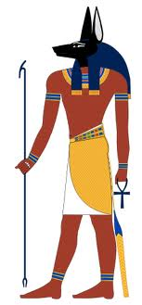
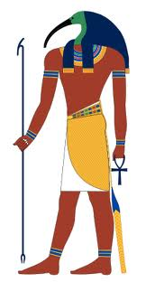
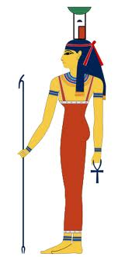
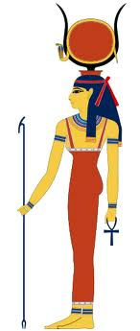
Mummification & The Afterlife
The ancient Egyptians had one great wish. That wish was to live forever. Egyptians believed that after they died a new life began. They would live in their tombs as they lived on earth. They would also travel to another world to live with the gods and goddesses of the dead.

Slide 2
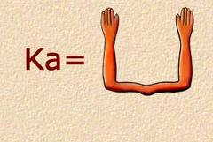
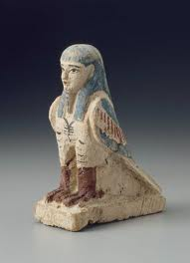
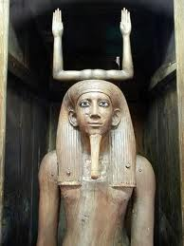
Mummification & The Afterlife
Egyptians believed that everyone had a ba, or soul, and a ka, an invisible twin of the person.
Hieroglyphic symbol for ka
Statue symbolizing the ka
The ba was represented as a bird with a human head.

Slide 3
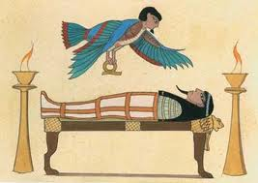
Mummification & The Afterlife
They believed that when a person died, his ba and ka were released from his body and lived on in the tomb. The ba would keep contact with the living family and friends of the dead. The ka traveled back and forth from the body to the other world. In order for a person to live forever, the ba and ka had to be able to recognize the body, or they could not return to it. That is why the body had to be preserved, or mummified.
The ba returned to the body at night

Slide 4
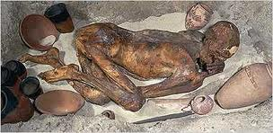
Mummification & The Afterlife
A mummy is a corpse that has been dried out so it will not decay. The earliest Egyptians were mummified naturally. The corpse was buried in the ground. The hot dry sand of Egypt dried out the body. The preserved body turned as hard as stone, into a fossil.
The corpse was buried in a crouching position. Jars of food were buried with it for use in the new life.

Slide 5
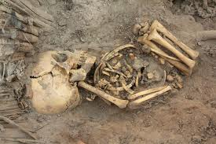
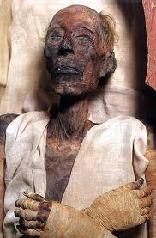
Mummification & The Afterlife
As time went on, burials became more elaborate. The dead were wrapped in a shroud of cloth or skin. They were buried in pits lined with wood or stone, or in caves. Bodies not buried directly in the sand became exposed to dampness, air, and bacteria. They decayed.
So people learned how to embalm, or mummify, their dead. It took centuries of practice to perfect the art. Embalmers became so expert that the mummies they made remained preserved for thousands of years.

Slide 6
Mummification & The Afterlife
Mummification was a long, complicated, and expensive process. People were mummified and buried according to what they could afford.
The poor had modest burials (often buried in mass graves in the desert).
Noblemen and others who served the king and queen had more elaborate burials (larger tombs and more grave goods).
The Pharaoh was given the best burial because they became a god after their death.

Slide 7
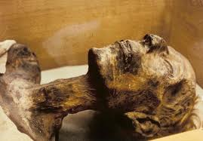
Mummification & The Afterlife
Let's look at the process a Pharaoh's body would have gone through when it was mummified:
Mummy of Ramses the Great

Slide 8
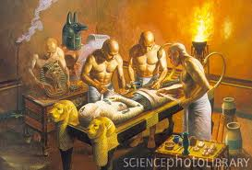
Mummification & The Afterlife
It took 70 days for embalmers to completely mummify a body. For a royal or noble burial, embalmers worked in workshops near the tomb where the mummy would be buried.
The process was done by priests.

Slide 9
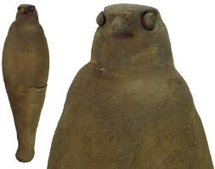
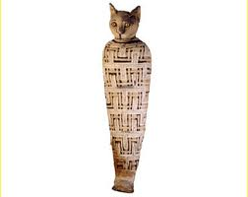
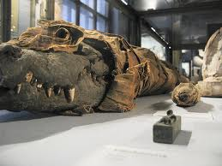
Mummification & The Afterlife
The Egyptians even embalmed and mummified animals, too. They mummified them the way they did people and buried them as sacrifices to a god or goddess.
Mummified Falcon
Mummified Cat
Mummified Crocodile

Slide 10
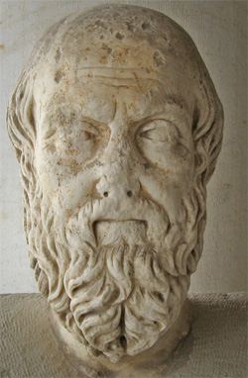
Mummification & The Afterlife
The exact process of mummification was never written down by the ancient Egyptians, but we do have one written source from an ancient Greek Historian, Herodotus, who traveled throughout Egypt around 490 B.C.E. This is what Herodotus had to say about mummification:

Slide 11
Mummification & The Afterlife
as much as possible of the brain is extracted through the nostrils with an iron hook, and what the hook cannot reach is rinsed out with drugs; next the flank is laid open with a flint knife and the whole contents of the abdomen removed; the cavity is then thoroughly cleansed and washed out, first with palm wine and again with an infusion of pounded spices. After that it is filled with pure bruised myrrh, cassia, and every other aromatic substance with the exception of frankincense, and sewn up again, after which the body is placed in natron, covered entirely over, for seventy days - never longer. When this period, which must not be exceeded, is over, the body is washed and then wrapped from head to foot in linen cut into strips and smeared on the under side with gum, which is commonly used by the Egyptians instead of glue. In this condition the body is given back to the family, who have a wooden case made, shaped like the human figure, into which it is put. The case is then sealed up and stored in a chamber, upright against the wall.
Herodotus, The Histories

Slide 12
Mummification & The Afterlife
Herodotus tells us of two other embalming techniques that were used for those who could not afford the first method:
The abdomen was injected with cedar-tree pitch (oil). This is stated by Herodotus to have had a corrosive and solvent action on the internal organs, causing them to liquefy. After the injection, the body was steeped a certain number of days in natron; the contents of the abdomen were allowed to escape (often through an enema); and the process was then complete.
The body was simply washed and covered with natron for 70 days.

Slide 13
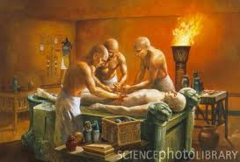
Mummification & The Afterlife
First, embalmers removed the internal organs.

Slide 14
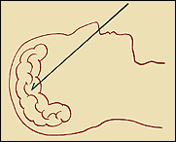
Mummification & The Afterlife
The bone in the nose was broken, and a metal rod was inserted into the brain. The embalmers then stirred the brain until it was liquefied. The head was then turned so the brain could drain out of the nose.

Slide 15
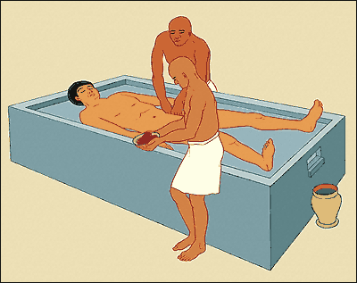
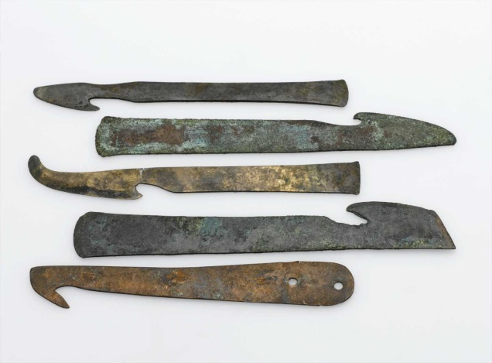
Mummification & The Afterlife
A cut is then made along the left side of the body and the liver, lungs, stomach, and intestines are removed. Each of these organs was embalmed in natron and placed in is own container called a canopic jar. The heart and kidneys were left in the body.
Mummification Tools

Slide 16
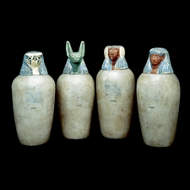
Mummification & The Afterlife
The internal organs were mummified separately from the body. Each organ was wrapped in linen and covered with a mask of the god that protected it. Then each mummified organ was put into its own canopic Jar. The lid of the jar also bore the image of the god that protected it (the four gods were the sons of Horus).
Canopic Jars

Slide 17
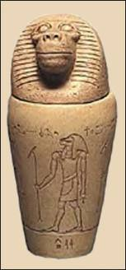
Mummification & The Afterlife
Hapi: God that guarded the lungs.
Hapi had the head of a baboon.

Slide 18
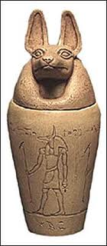
Mummification & The Afterlife
Duamutef (doo-am-u-tef): God who guarded the stomach.
Duamutef had the head of a Jackel.

Slide 19
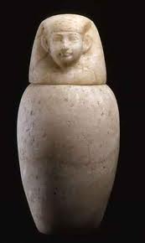
Mummification & The Afterlife
Imsety: God who guarded the liver.
Imsety had a human head.

Slide 20
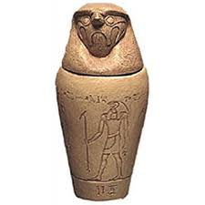
Mummification & The Afterlife
Qebhsenuef (kay-bay-sin-oof): god who guarded the intestines.
Qebhsenuef had a falcon head.

Slide 21
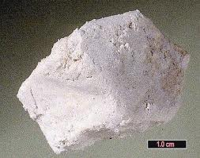
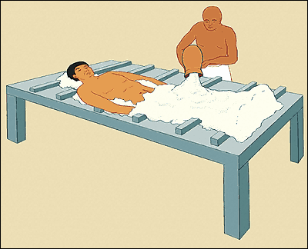
Mummification & The Afterlife
Small bundles of natron wrapped in linen were stuffed inside the body. The outside was covered with natron as well. The chemical dried out the body the same way the sand had.
Natron packets are stuffed into the body.
Natron

Slide 22
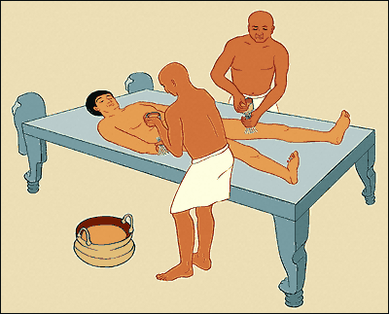
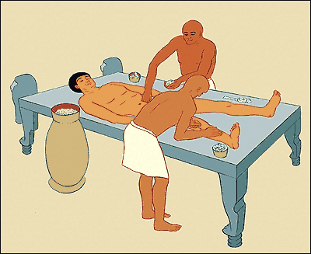
Mummification & The Afterlife
After forty days the natron packs were removed. The dried, shrunken body was sponged clean and brushed with oils, ointments, spices, and resin.
Oils and spices such as frankincense and myrrh are placed within the body.
Water from the Nile is used to remove the natron.

Slide 23
Mummification & The Afterlife
The head and body were stuffed with cedar saw dust, and the embaliming cut was covered with a plate of gold bearing the protective Eye of Horus.

Slide 24
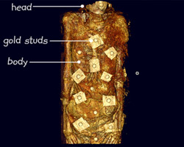
Mummification & The Afterlife
The eye sockets were plugged with linen and closed. The nostrils were stuffed with beeswax. The arms were crossed, and the mummy's fingernails and toenails were covered with caps of gold. The mummy was adorned with jewelry of gold and precious gem stones.

Slide 25
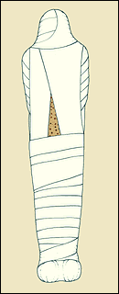
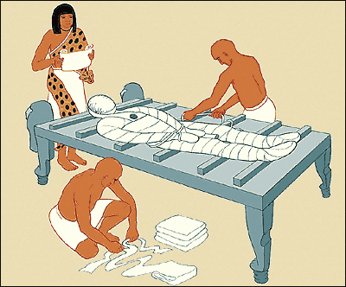
Mummification & The Afterlife
The body was then carefully bound with long, narrow strips of linen. Fingers, toes, arms and legs were wrapped individually. Linen shrouds were placed between the layers of binding and every few layers were glued together with resin. After 20 layers of shrouds and binding, the mummies body took on its normal size.
Resin was used to bind or glue the linen together
wrapping the body in linen

Slide 26
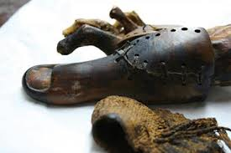
Mummification & The Afterlife
It was possible, during the long process, that a piece of the corpse - an ear or a toe - would fall off. This and all leftover material used for the embalming were saved in jars to be buried near the tomb.

Slide 27
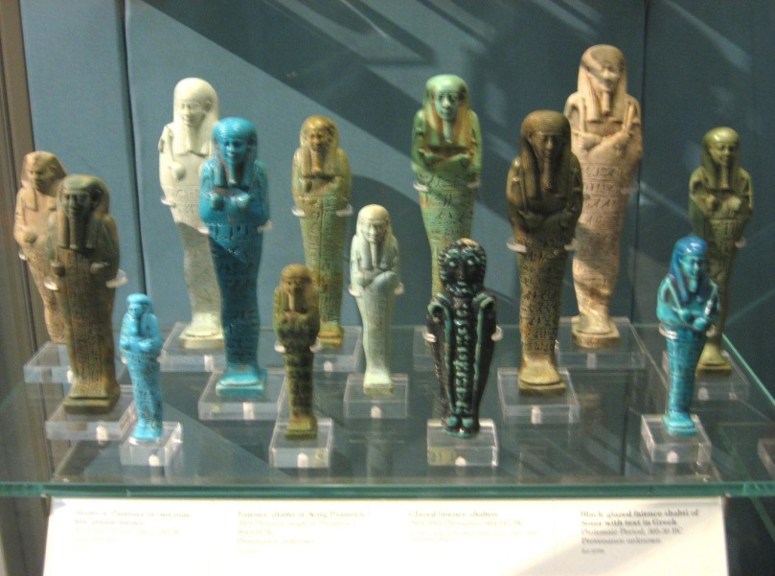
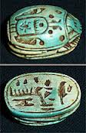
Mummification & The Afterlife
Magical amulets, called scarabs, were tucked in between the mummy's wrappings. The small mummy-shaped figures called shabtis held farm tools. The shabtis would work in the fields of the other world for the mummy.
Scarabs
Shabtis

Slide 28
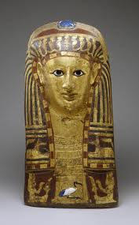
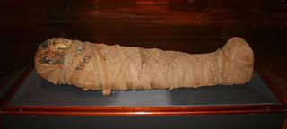
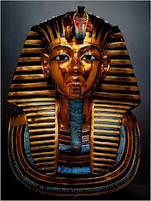
Mummification & The Afterlife
The bound head was covered with a portrait or funeral mask. If anything happened to the mummy, the ba and the ka would still be able to recognize it. The mask was bound, and the whole package was wrapped in a shroud and given a last coat of resin. The mummy was finished.
Some masks were made of wood.
The final product
Some masks were made of gold.

Slide 29
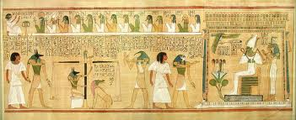
Mummification & The Afterlife
A copy of the Book of the Dead was buried with the mummy. The spells, written and illustrated on scrolls of papyrus, were to help the dead find everlasting life in the other world.

Slide 30
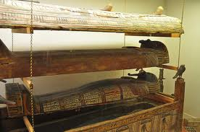
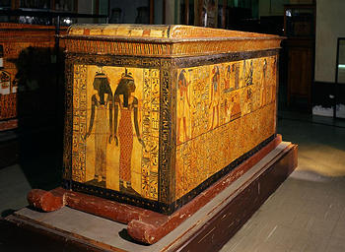
Mummification & The Afterlife
Meanwhile, skilled artists, sculptors, and carpenters prepared for the burial. They made the coffin or a nest of coffins, called a sarcophagus. The sarcophagus was painted inside and out with gods, goddesses, and magic spells of protection.
Nested Sarcophagus
Sarcophagus

Slide 31
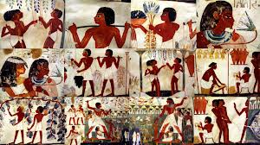
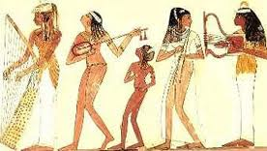
Mummification & The Afterlife
The walls of the royal tombs were carved and painted with scenes that would magically come alive. The scenes showed the person's new life in the other world. Dancers and musicians entertained him. Servants worked in the fields and carried food for him to eat. The gods and goddesses of the dead welcomed him.
Musicians
Field Workers

Slide 32
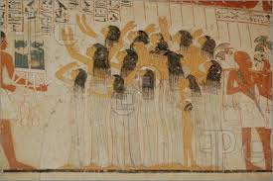
Mummification & The Afterlife
A funeral procession followed the mummy to its tomb. The more people in the funeral procession, the higher the person's rank in society. Nobles and Pharaoh's often paid people to join their funeral procession to show their importance.

Slide 33
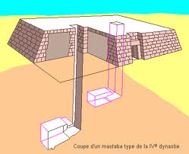
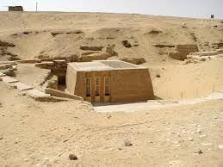
Mummification & The Afterlife
A tomb was no longer just a pit in the desert sand. It was a house for the mummy, the ba, and the ka that would last forever. A royal tomb was also a fortress against robbers who tried to steal mummies and their treasures. People had tombs built during their lifetimes. For Centuries, the dead were usually buried in tombs called mastabas. Mastabas were made of brick and stone. Royal mastabas had many storage chambers and were beautifully carved and decorated.

Slide 34
Mummification & The Afterlife
As years went by, pharaohs took more and more with them into their tombs. Tombs became bigger, stronger, and more elaborate. For a long time, pharaohs had pyramids built for themselves. Pyramids were huge stone monuments that took hundreds of workers their lifetime to build.

Slide 35
Mummification & The Afterlife
Tombs were built in the desert, where the land could not be farmed. Sometimes the mourners brought the mummy by boat up the Nile River. The boat that carried the mummy was buried near the tomb for the mummy to use in the afterlife.
Pharaoh Khufu's boat buried at
the foot of the Great Pyramid.

Slide 36
Mummification & The Afterlife
The pyramid covered the pharaoh's burial chamber. Near it were temples, storage chambers, and mastabas where the royal family and servants would be buried. Later, pharaohs were buried in secret underground tombs in a deserted place known as the Valley of the Kings.

Slide 37
Mummification & The Afterlife
When the funeral procession came to a rest at the tomb, priests performed a final ritual on the mummy called the "Opening of the Mouth". The mummy's mouth was not actually opened, but magically given the ability to speak and eat again.

Slide 38
Mummification & The Afterlife
The mummy was then put into the sarcophagus. The canopic jars were stored nearby. The mourners left, and the entrance to the tomb was sealed up with a wall of stone slabs. Finally, the mummy was in its eternal resting place and on the way to its new life.

Slide 39
Mummification & The Afterlife
Mini-Assignment: Now that we have seen how the ancient Egyptians created mummies, we are going to create a short flipbook that correctly arranges the steps in the mummification process, and provides a picture for each one of the steps. Your first task will be to put the following steps in order from start to finish:
· Put the Mummy in a sarcophagus.
· Put natron packets in the body.
· Put internal organs in canopic jars.
· Stuff the inside of the body with linen.
· Cover the entire body with natron.
· Place magic amulets on the mummy.
· Rub the body with spices and oils.
· Remove the internal organs.
· Paint a picture of Osiris on the mummy.
· Wash natron off the body.
· Wrap body in linens.
· Cover the mummy with a layer of resin or tree sap.
· Remove the brain.

